Slide 1

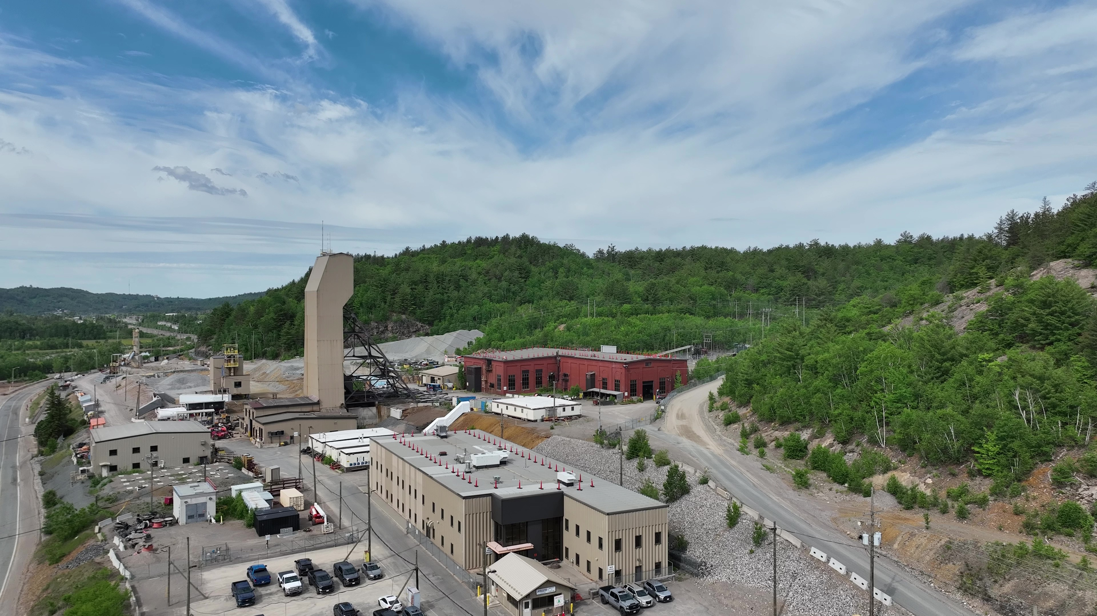







www.magnamining.com
Copper, nickel & precious metal production growth in Sudbury, North America’s premier mining district
OCTOBER
2026
TSX:
NICU
OTC:
MGMNF

Slide 2
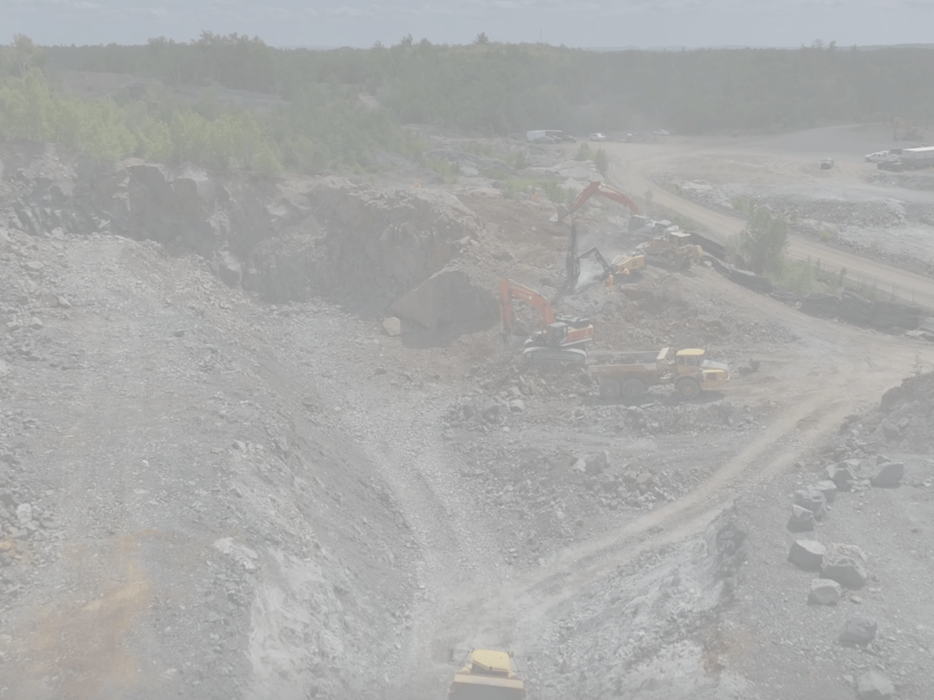


CAUTIONARY STATEMENTS
Cautionary Statement Regarding Forward-Looking Information
This presentation contains forward-looking information and forward-looking statements (collectively, "forward-looking statements") within the meaning of applicable securities laws. All statements, other than statements of historical fact, are forward-looking statements and are based on expectations, estimates and projections as of the date hereof. Statements with respect to predictions, expectations, plans, projections, future events or performance, often but not always using words such as "develop", "growth", "believe", "expect", "potential", "intend", "should", "could", "seek", "anticipate", "will", "positioned", "project", "risk", "plan", "may", "can", "might", "estimate", "interpreted", "significant", "forecast", or, in each case, their negative and words of similar meaning are not statements of historical fact – rather, they are forward-looking statements. In this presentation, forward-looking statements relate to, among other things, statements regarding the future plans and objectives of Magna Mining Inc. (the "Company" or "Magna"), production plans and cash flows relating to the McCreedy West Mine, the commencement or start of mining or development at the Company's other assets, such as the Levack Mine or the Crean Hill Project, the exploration or development potential of the Company's assets to grow the Company into a meaningful mid-tier producer with multiple producing assets, mineral resource or mineral reserve estimates and the resource or reserve potential of the Company's assets, the prospects generally of the Company's assets, such as the Levack Mine, the Crean Hill Project, the Podolsky Mine and the Kirkwood Project, estimates of reclamation liabilities, estimates of future metal prices, anticipated future revenue streams and potential sources of additional financing, and the integration of assets acquired by the Company in corporate or asset transactions.
All forward-looking statements involve various assumptions, estimates, risks and uncertainties and actual results may differ materially from those communicated in such statements. These risks and uncertainties include, but are not limited to, risks and uncertainties relating to the ability of the Company to successfully operate mining operations and develop development projects, the ability of the Company to complete further exploration projects, such as drilling programs and assaying, the security of the Company's interest in and title to its properties; the potential of exploration activities and assay results to accurately predict mineralization, errors in management's geological and financial modeling, the ability of the Company to maintain all current permits, authorizations and mineral tenure in good standing, the ability of the Company to obtain and maintain necessary government approvals, the ability of the Company to complete further accretive transactions, the ability of the Company to successfully execute on its production, development and exploration plans, the ability of the Company to attract and retain qualified talent to successfully execute on its strategy, changing legislative and regulatory environments, the impact of competition, the timing and amount of required capital and other expenditures to advance its operations and projects, conditions in financial markets and the economy generally, the ability of the Company to obtain additional financing on satisfactory terms, if at all, the ability of management of the Company to operate and grow the business effectively, fluctuations in metal prices, the speculative nature of mining and mineral exploration and development, as well as those risk factors discussed or referred to in the Company’s continuous disclosure filings with the securities regulatory authorities in Canada available on SEDAR+ at www.sedarplus.ca, including in its management discussion and analysis for the year ended December 31, 2024.
Scientific and Technical Information
The scientific and technical information contained in this presentation has been reviewed and approved by David King, M.Sc, P.Geo, a "Qualified Person" for the purposes of National Instrument 43-101 – Standards of Disclosure for Mineral Projects ("NI 43-101").
Currency
All amounts discussed herein are denominated in Canadian dollars unless otherwise specified.
02

Slide 3

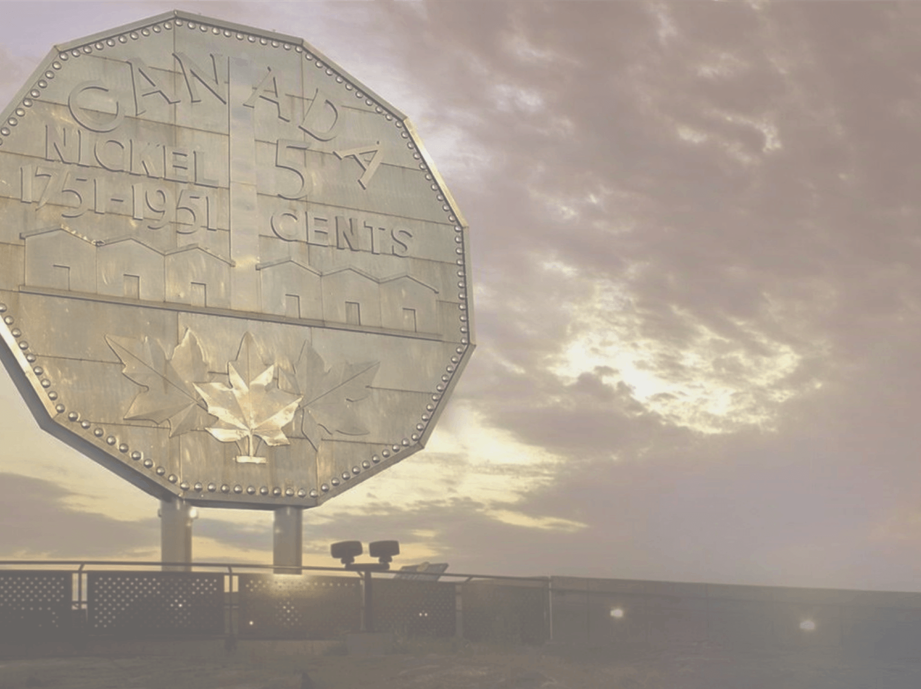












THE SUDBURY ADVANTAGE
Infrastructure & processing facilities
Over 100 years of mining
Social license to operate
World class mineral endowment
Local, provincial & federal government support
03

Slide 4
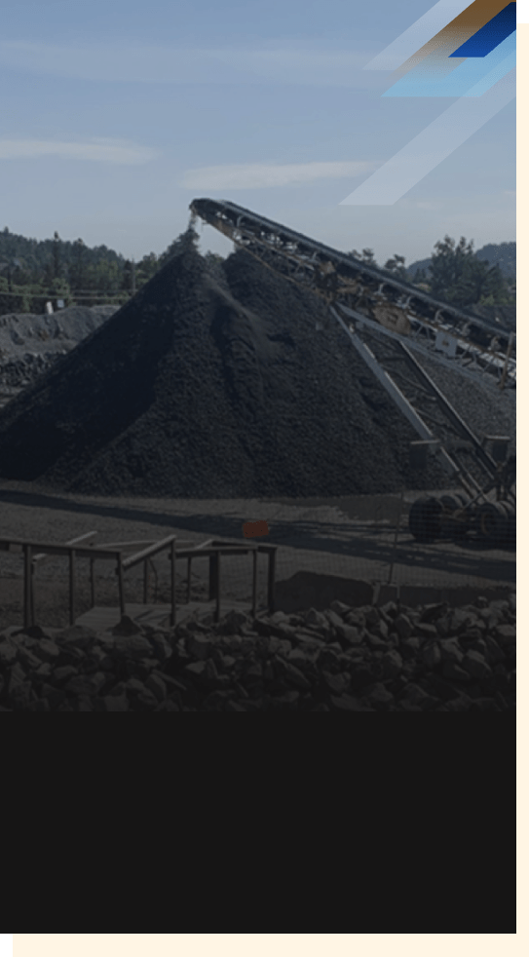
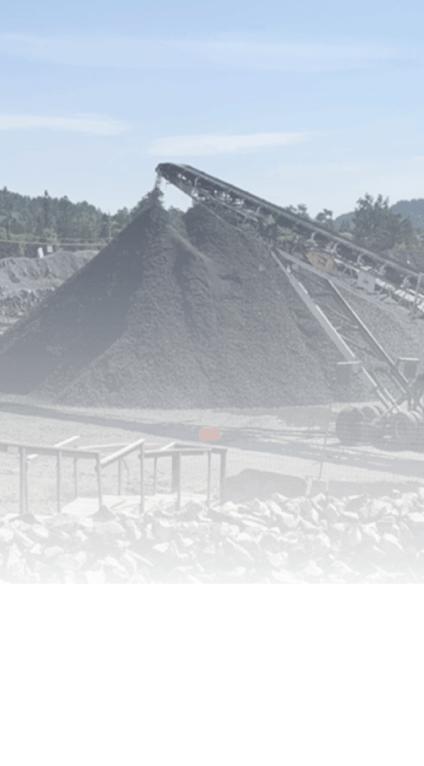
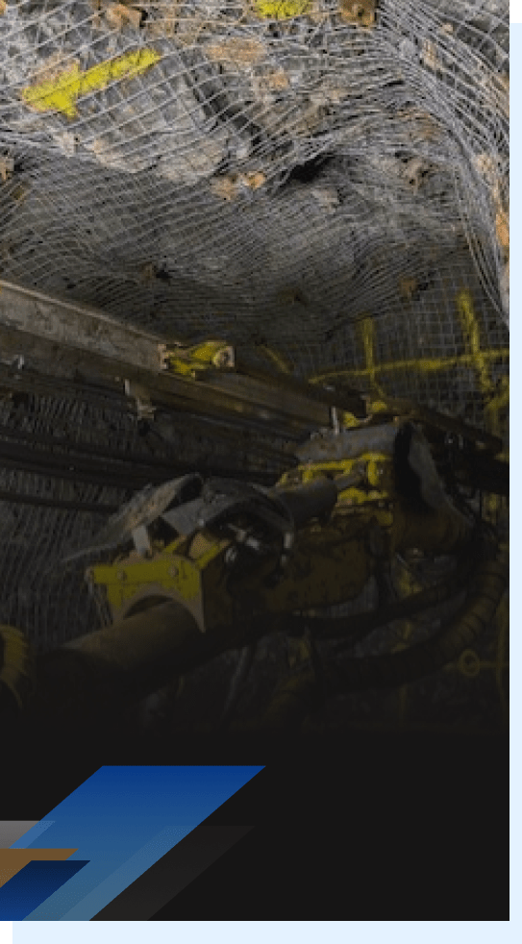
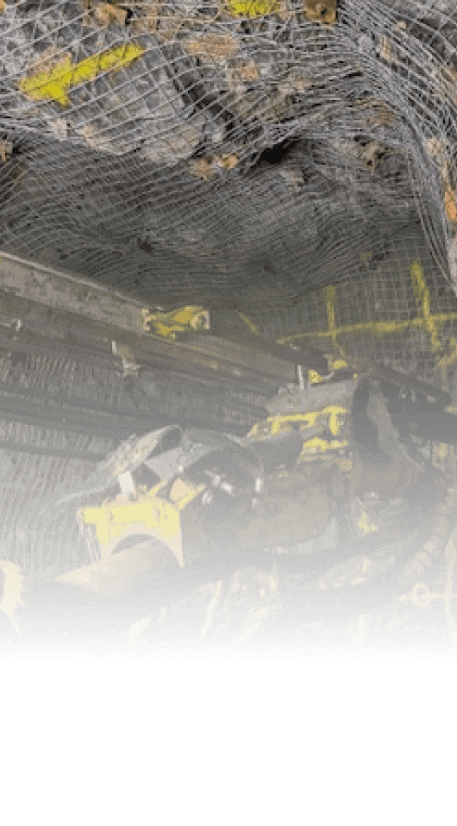
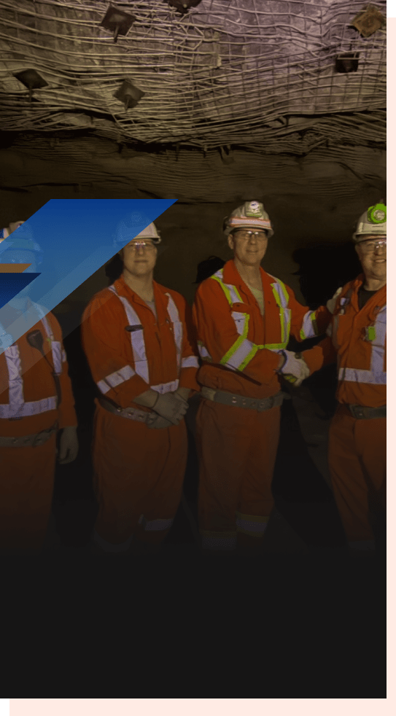
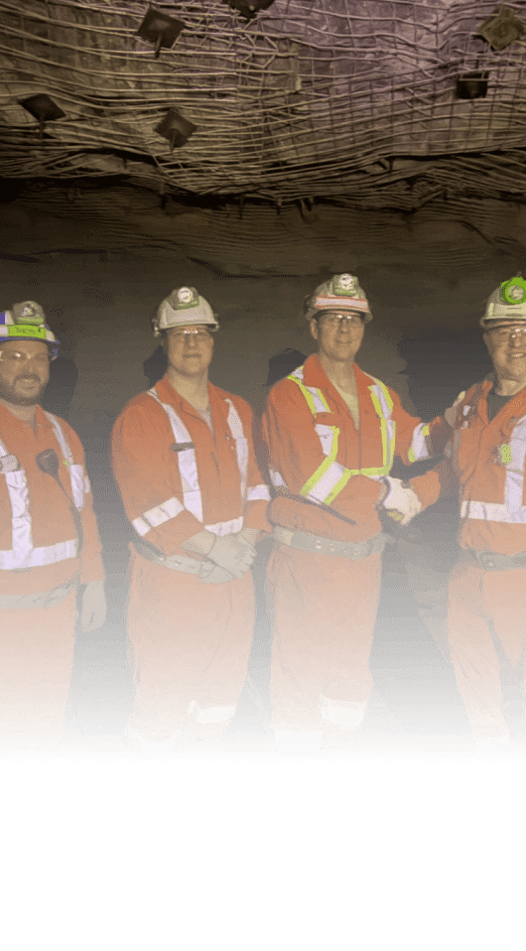
MAGNA MINING
Pillars of Growth
PRODUCTION
EXPLORATION
SYNERGISTIC ACQUISITIONS
Currently one producing copper mine (McCreedy West)
Four permitted, past producing mines
Focused on copper and precious metals (PGE-gold-silver), with optionality for rapid nickel production re-start
Experienced Sudbury exploration team
Track record of making significant discoveries in Sudbury
Utilizing a large proprietary data base to develop targets
Track record of acquiring accretive projects in Sudbury
Targeted acquisitions are non-core to their current owners
Targeting deposits with synergies to existing mines and infrastructure
04

Slide 5




SUDBURY
A World Class Mining District
~200km to
Timmins
LEVACK
PODOLSKY
Sudbury
Toronto
Glencore
Strathcona Mill
McCREEDY WEST
Levack
Glencore
Falconbridge Smelter
Chelmsford
Vale Clarabelle Mill
Vale Copper Cliff Smelter
City of Sudbury
SHAKESPEARE
Whitefish
Wanup
Nairn
CREAN HILL
Magna Property
Massey
05
~400km to
Toronto

Slide 6
A Clear Pathway to Multi-Asset
Copper-Nickel-Precious Metals Production in Sudbury
EXPLORATION
&
ACQUISITION
OF OTHER ASSETS
PRODUCTION
PERMITTED, PAST-PRODUCING DEVELOPMENT PROJECTS
OTHER PROPERTIES
Increasing Copper Equivalent
Production
SHAKESPEARE
Permitted for a 4,500 tpd mill
PODOLSKY
Strategic existing shaft & ramp to North Zone
CREAN HILL
PFS completion in Fall 2026 followed by construction decision
LEVACK
PEA completion in Fall 2026 followed by production restart decision
McCREEDY WEST
Producing copper-nickel-precious metals mine
06

Slide 7
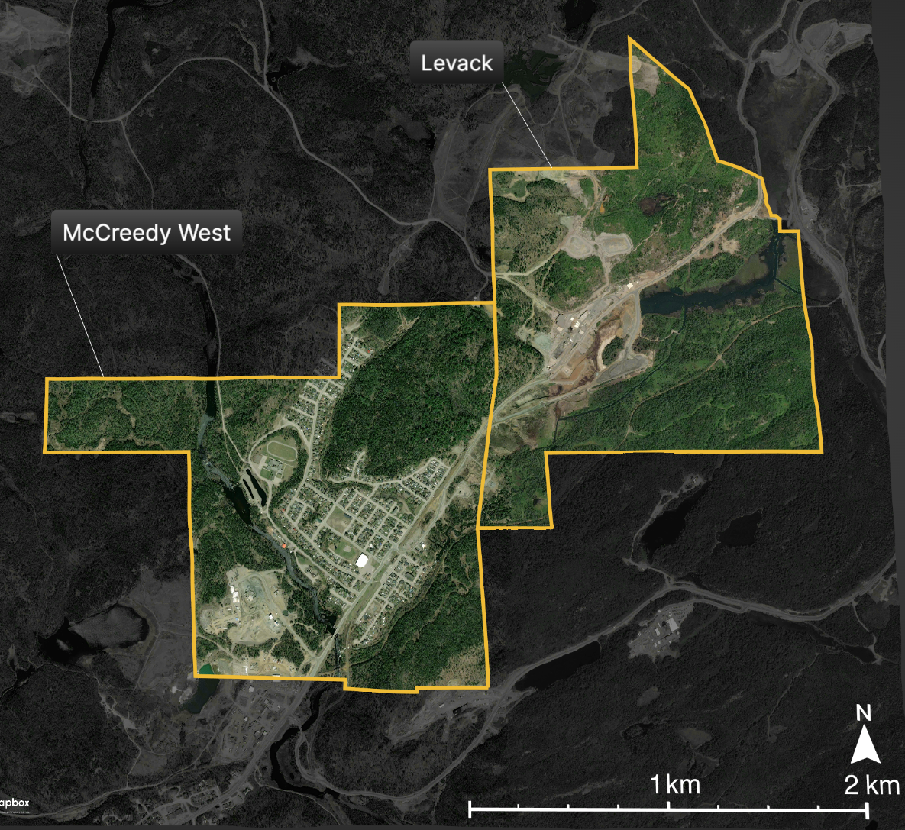
McCreedy West & Levack
North Range, Sudbury Basin
Vale Coleman Mine
Glencore Strathcona Mill
Glencore Fraser Mine
McCreedy West Portal
Levack #2 Shaft
Levack Townsite
Glencore Hardy Mine
Glencore Craig Mine (Onaping Depth Project)
Glencore Onaping Mine
07
7

Slide 8
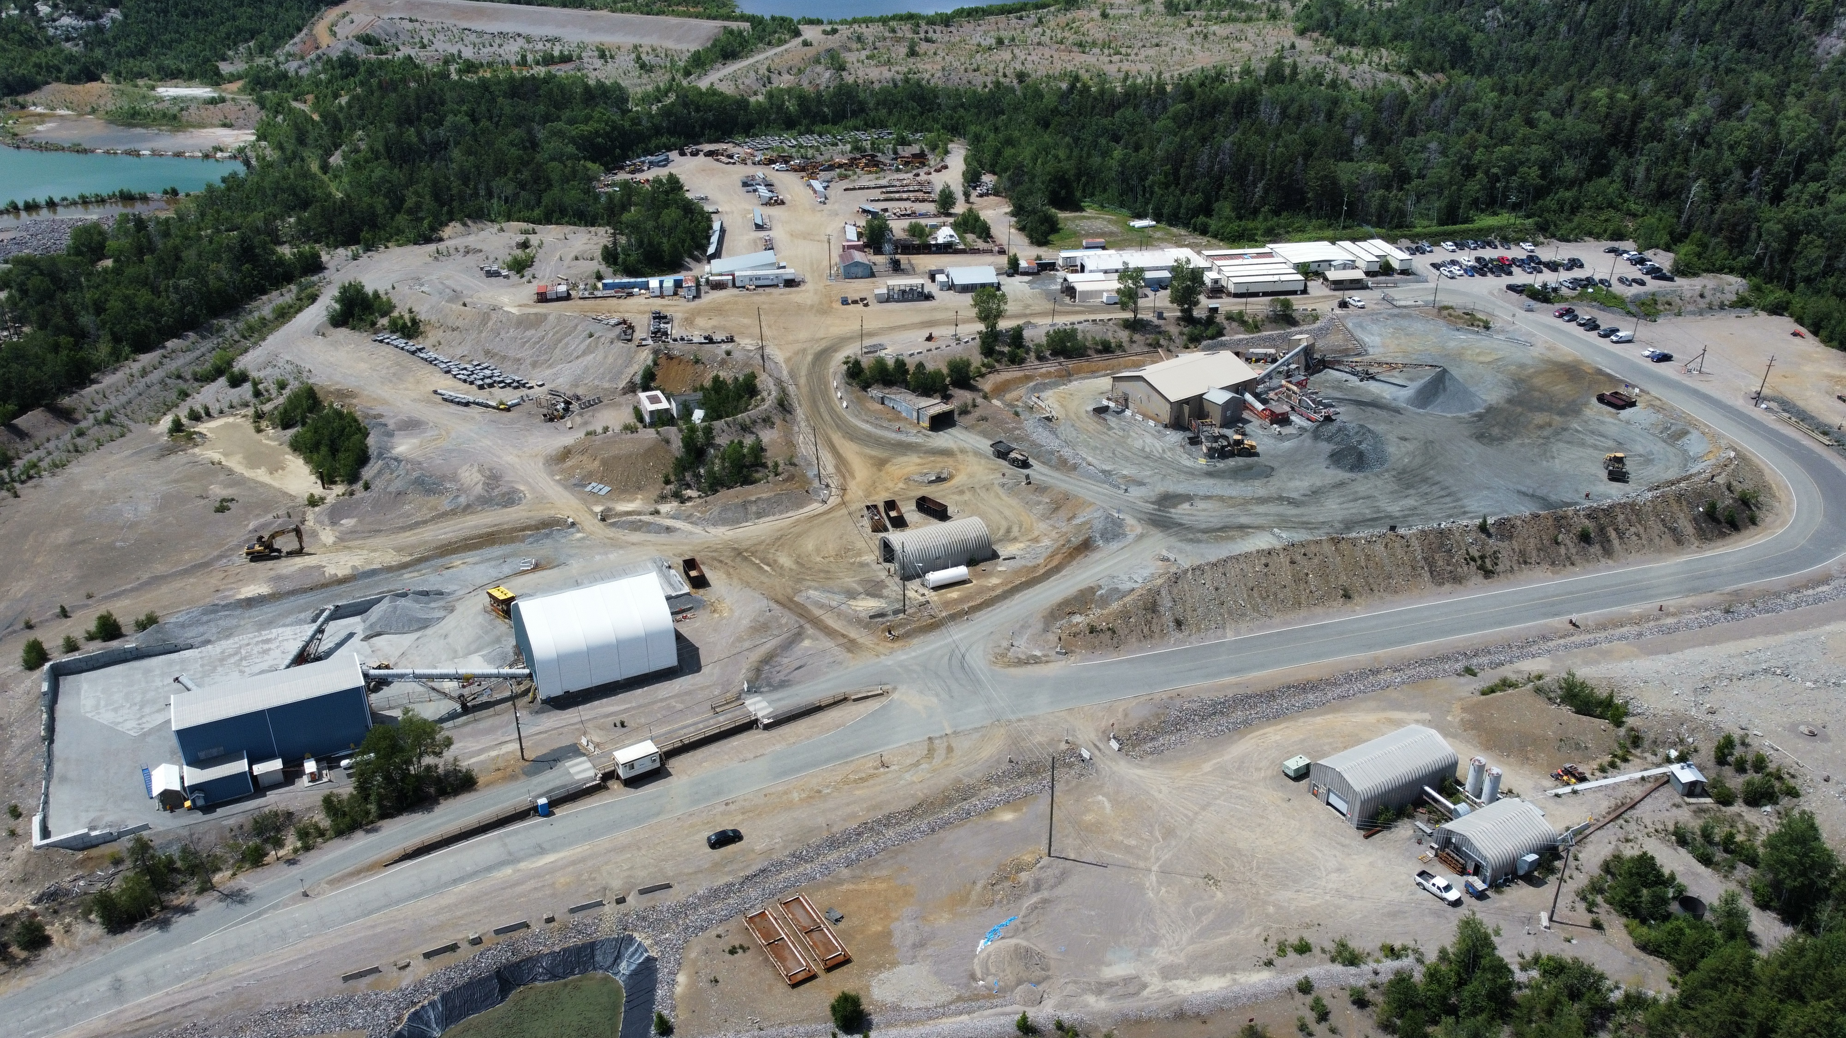
McCreedy West Mine
Producing Copper-Precious Metals-Nickel Mine
Administrative Complex
Security
Portal
Ore Sorter
Crusher, Sample Tower, Shipping
08

Slide 9
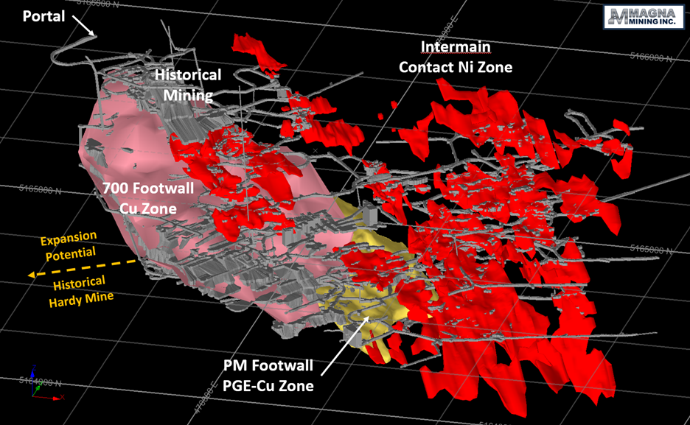

McCreedy West Mine
Producing Copper-Precious Metals-Nickel Mine
250 m
250 m
Current production is from the 700 Footwall Copper Zone
Actively evaluating the restart of production from the Intermain Nickel Zone
Development and exploration initiatives will focus on the area to the west of the 700 FW Zone towards the historical Hardy Mine (Glencore)
09

Slide 10
McCreedy West Mine
H1 2026 Highlights
Produced 8.6 million copper equivalent (“CuEq”) payable pounds in H1 2026 and continue to expect to achieve full year 2026 guidance for all metrics, including production of 16.0-18.0 million CuEq payable lbs
McCreedy West shipped 180,742 tons of ore from the 700 Footwall Copper Zone in H1, with record tonnage of 98,446 tons achieved in Q2 of 2026
Average grade in H1 of 3.34% copper equivalent (“CuEq”), based on the commodity prices assumed in the Company’s 2026 production and cost guidance (see following slide)
H1 cash costs* and All-in sustaining costs* (“AISC”) of US$3.63 per CuEq lb, and US$4.39 per CuEq lb, respectively. Production costs per ton processed in Q2 declined by 6.9% quarter over quarter to $199 per ton
Generated record positive cash margin of $8.9 million and free cash flow of $5.1 million in Q2 2026
 | 2026 |  | 2025 |  |  |  | 2026 | 2025
 | Q2 | Q1 | Q4 | Q3 | Q2 | Q1 (March only) | H1 | H1
Tons Processed | 98,446 | 82,296 | 84,954 | 75,215 | 70,045 | 20,388 | 180,742 | 90,433
CuEq Grade (%)¹ (contained) | 3.34 | 3.38 | 3.41 | 2.64 | 3.26 | 3.01 | 3.36 | 3.20
CuEq lbs¹ (contained, '000s) | 6,580 | 5,546 | 5,789 | 3,973 | 4,551 | 1,229 | 12,126 | 5,780
CuEq lbs¹ (payable, '000s) | 4,533 | 4,085 | 4,968 | 2,735 | 3,053 | 790 | 8,618 | 3,843
*Refer to the section entitled “Non-IFRS Performance Measures” for the reconciliation of these non-IFRS measurements to the financial statements.
“Cash Margin” is calculated as the difference between total sales revenue, net of smelting, refining and treatment costs from mining operations, and the cash mine site operating costs.
¹ Copper equivalent payable pounds and copper equivalent payable grade were calculated using the following US dollar prices:
Q2 2026: $6.04/lb Cu, $8.23/lb Ni, $26.27/lb Co, $1,914.26/oz Pt, $1,410.25/oz Pd, $4,512.69/oz Au, $73.19 Ag.
Q1 2026: $5.83/lb Cu, $7.87/lb Ni, $25.90/lb Co, $2,205.17/oz Pt, $1,713.42/oz Pd, $4,875.39/oz Au, $84.39 Ag.
Q4 2025: $5.03/lb Cu, $6.75/lb Ni, $23.01/lb Co, $1,679.68/oz Pt, $1,468.65/oz Pd, $4,141.90/oz Au, $54.83 Ag.
Q3 2025: $4.44/lb Cu, $6.81/lb Ni, $15.90/lb Co, $1,383.49/oz Pt, $1,169.18/oz Pd, $3,455.50/oz Au, $39.38 Ag.
Q2 2025: $4.29/lb Cu, $6.88/lb Ni, $15.81/lb Co, $1,072.35/oz Pt, $990.29/oz Pd, $3,301.29/oz Au, $33.64 Ag.
Q1 2025: $4.40/lb Cu, $7.18/lb Ni, $15.38/lb Co, $944.31/oz Pt, $1,005.61/oz Pd, $3,135.60/oz Au, $34.61 Ag.
YTD 2026: $5.94/lb Cu, $8.05/lb Ni, $26.08/lb Co, $2,059.72/oz Pt, $1,561.83/oz Pd, $4,875,39/oz Au, $78.79 Ag.
YTD 2025: $4.32/lb Cu, $6.95/lb Ni, $15.70/lb Co, $1,040.34/oz Pt, $994.12/oz Pd, $3,259.87/oz Au, $33.88 Ag.
10

Slide 11
McCreedy West Mine
2026 Guidance
2026 McCREEDY WEST OPERATIONAL GUIDANCE
700 Copper Zone Ore Sales (short tons) | 355,000 | - | 375,000
Copper Equivalent Grade¹ (% CuEq) | 3.2% | - | 3.5%
Payable Copper Equivalent Production¹ (million lbs CuEq) | 16.0 | - | 18.0
Total Cash Cost, excluding stream payments² (US$/lb CuEq) | $3.40 | - | $3.80
AISC, excluding stream payments² (US$/lb CuEq) | $4.20 | - | $4.70
¹ Copper equivalent payable pounds for the purpose of copper equivalent grade, cash costs and AISC were calculated using the following US dollar prices:
$4.88/lb Cu, $7.72/lb Ni, $18.12/lb Co, $1,410/oz Pt, $1,156/oz Pd, $3,815/oz Au, $50.00/oz Ag, and CAD/USD exchange rate of 1.37.
²The incremental cost impact of the precious metals stream varies significantly based on commodity prices. At the 2026 budget commodity prices outlined above the cost impact is approximately US$0.78-0.92/lb.
11

Slide 12
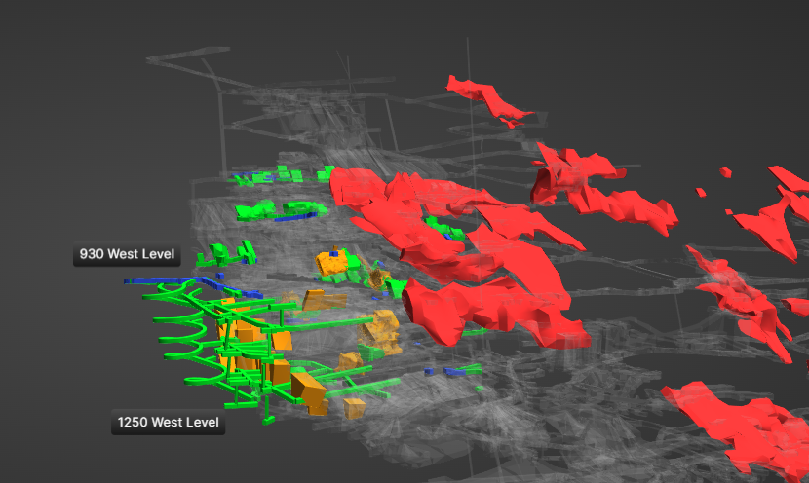
McCreedy West Mine
2026 Production Plans
Isometric Looking North
Portal
Scale
Blue – 2026 Development
Green – Planned Development & 2026 Cu Stopes
300 Ft
Orange – Planned Cu Stopes
Red – Intermain Ni Contact Deposit
Initial Mineral Reserve Estimate announced in Q1 2026 to support a 3-year production profile from the Footwall 700 Copper and PM Zones¹
Additional Mineral Resources include 5.6 million tonnes Indicated and 0.9 million tonnes Inferred¹
12
¹ See Footnotes to the McCreedy West Mineral Reserve & Mineral Resource Estimate.

Slide 13
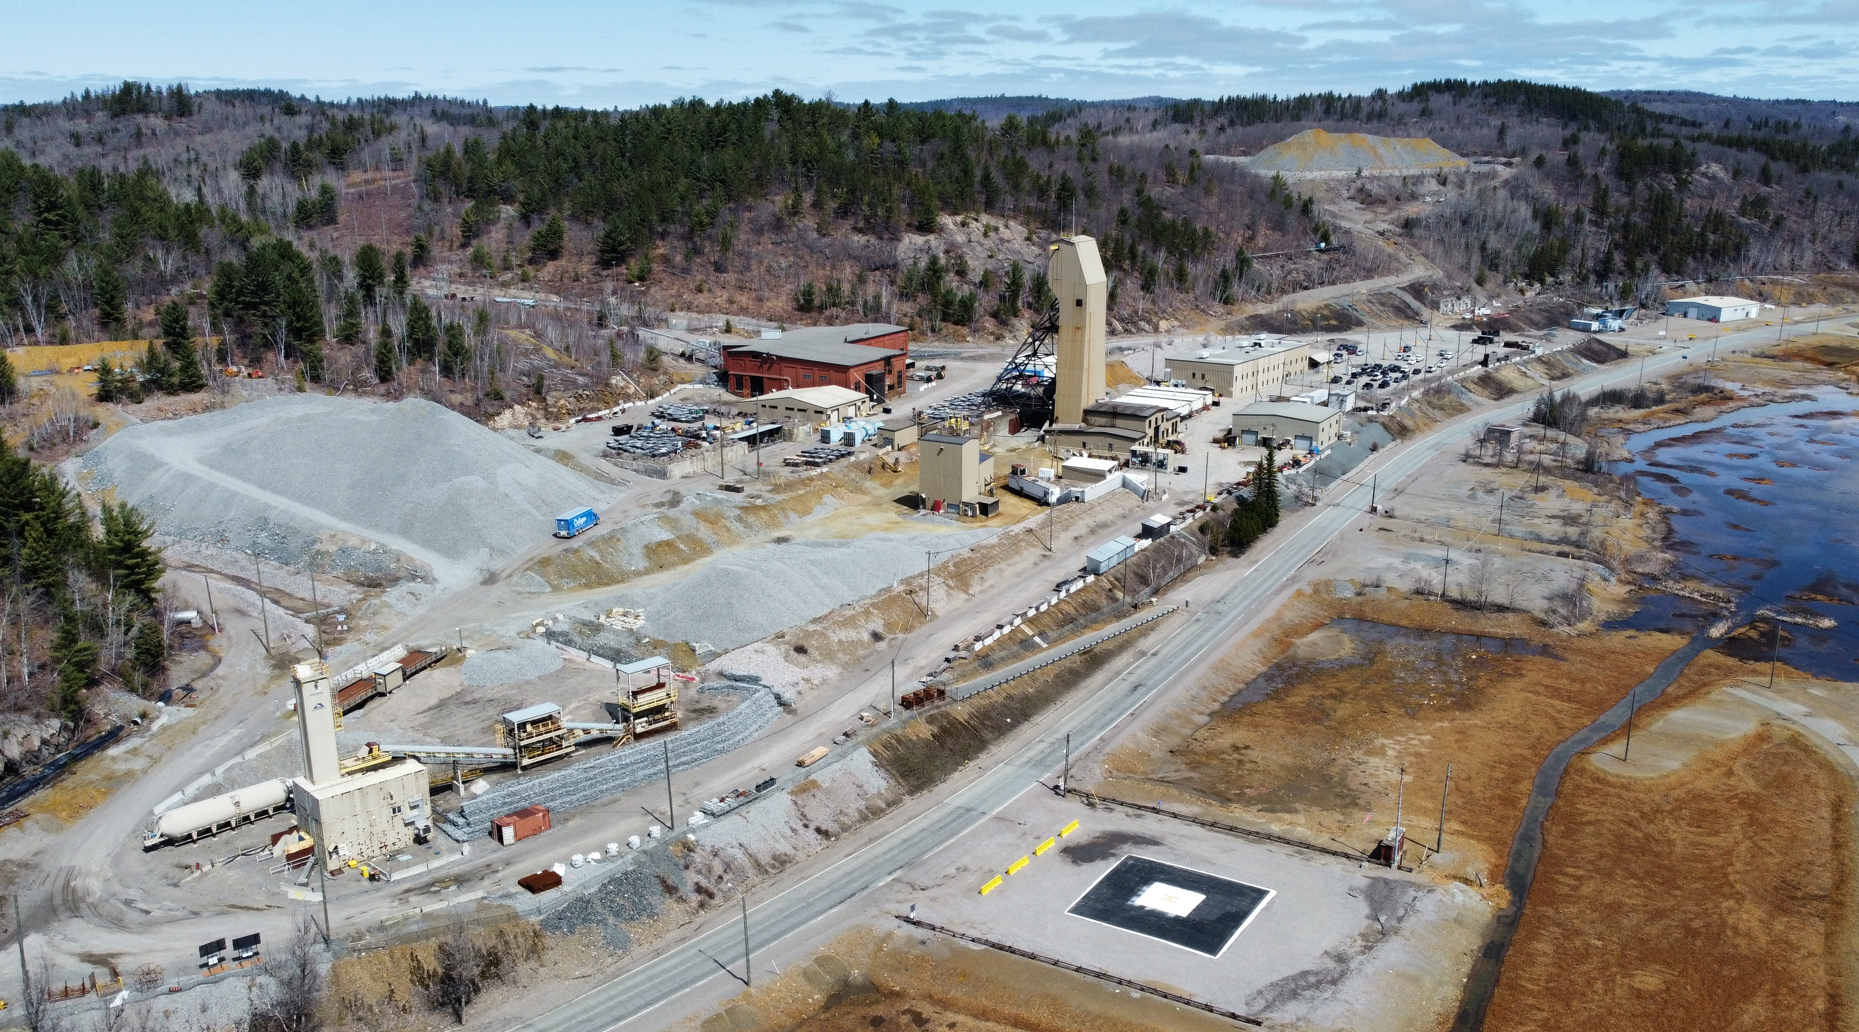
Levack Mine
Past-Producing Nickel-Copper-Precious Metals Mine
Levack #2 Shaft
Administration Building
Security
Vale Coleman Mine
Core Shack
Proposed Portal
Glencore Strathcona Mill
Sample Tower
Backfill Plant
Glencore Onaping Depth Project
13

Slide 14
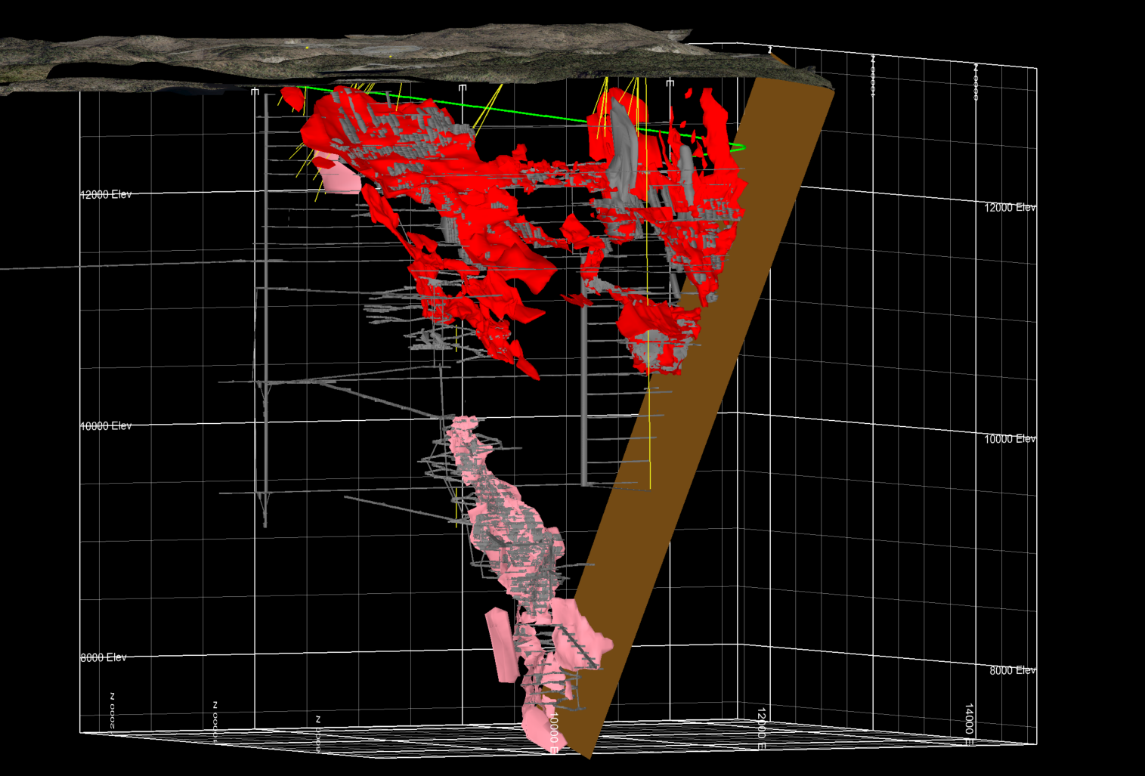
Levack Mine
Past-Producing Nickel-Copper-Precious Metals Mine
Conceptual Ramp From Surface
MLV-25-21
2.3% Ni, 0.7% Cu over 28.0m Including 6.6% Ni, 0.7% Cu, over 2.4m
And 3.3% Ni, 1.0 % Cu over 12.4 m
MLV-25-22
2.4% Ni, 0.8% Cu, over 15.5m And 3.2% Ni, 2.2% Cu over 2.4 m
Main Ni-Cu Zone
Keel Cu-PGE Footwall Zone
No. 1 & No. 2 Ni-Cu Zones
No. 3 Ni-Cu Zone
No.2 Shaft
MLV-25-14A
Fecunis Fault
Morrison Cu-PGE Footwall Zone
500 ft
14

Slide 15
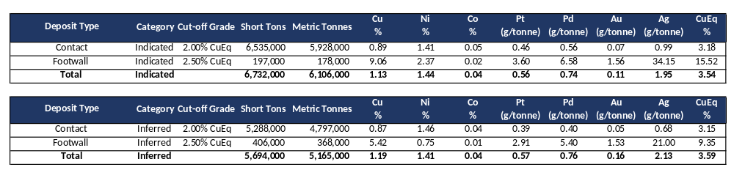
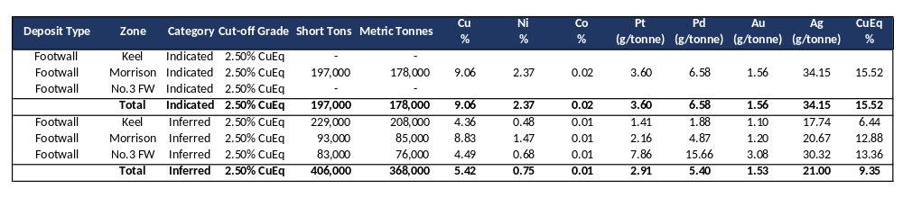
Levack Mine
Mineral Resource Estimate
¹See Footnotes to the Levack Mineral Resource Estimate.
15

Slide 16
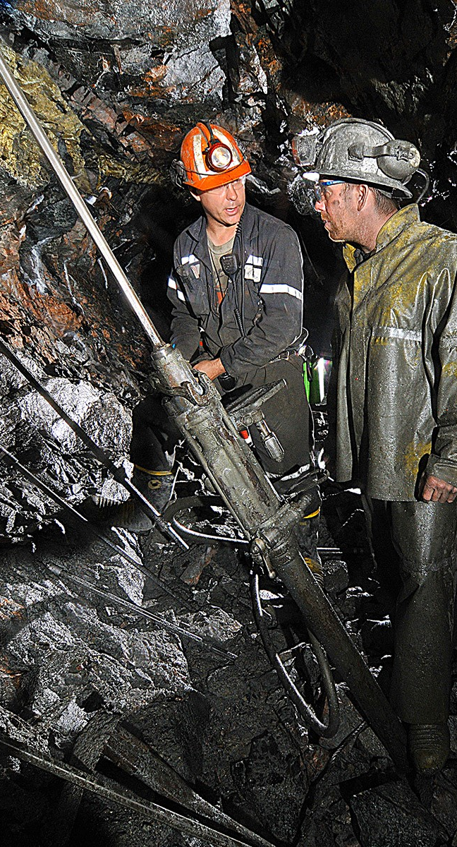
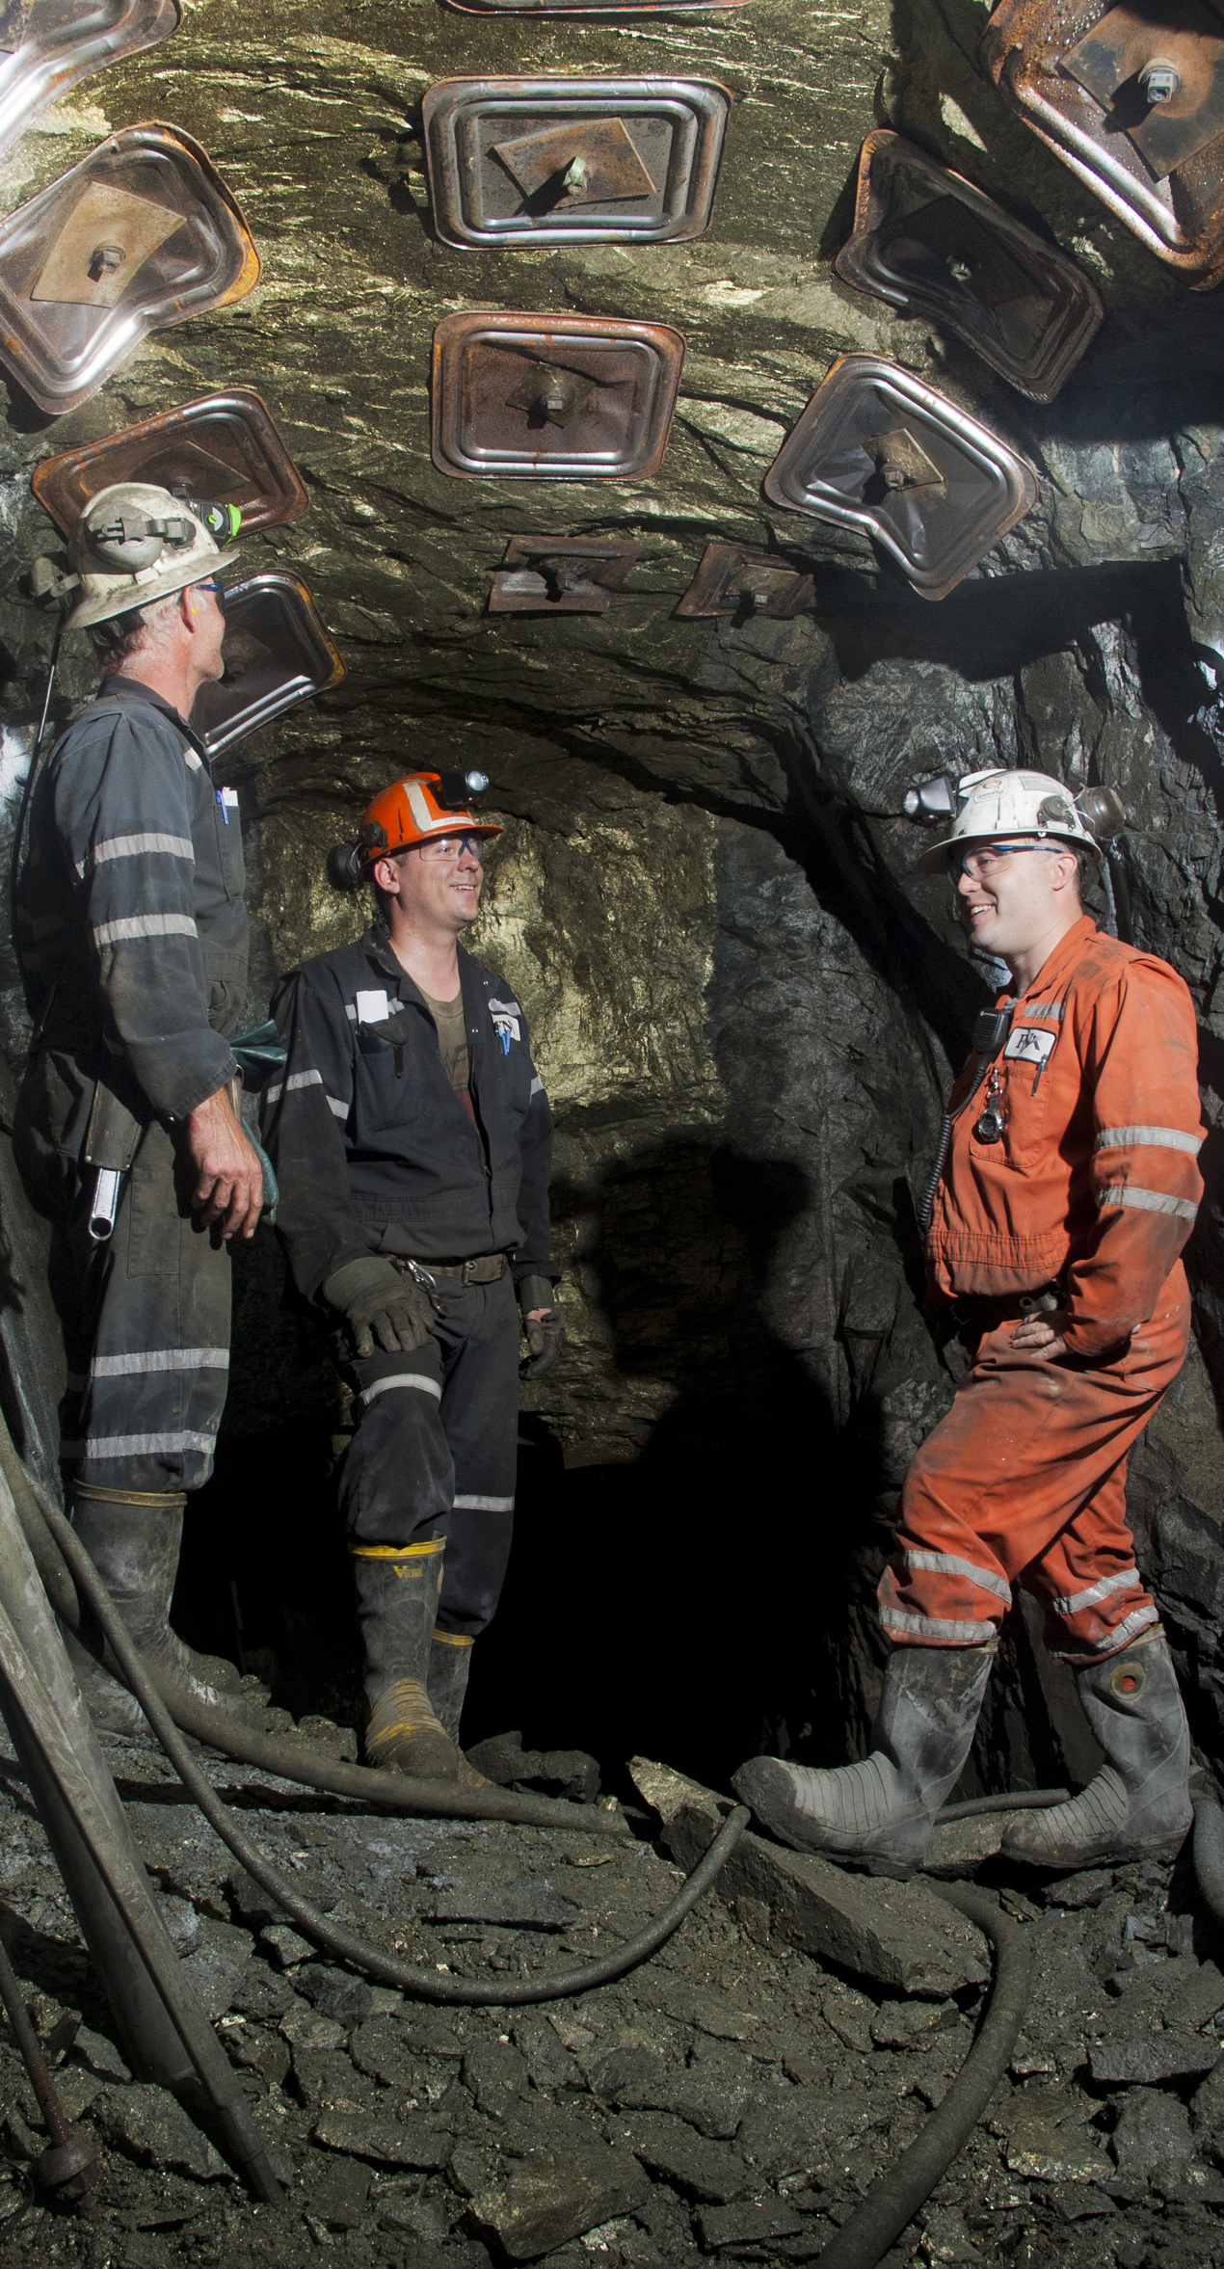
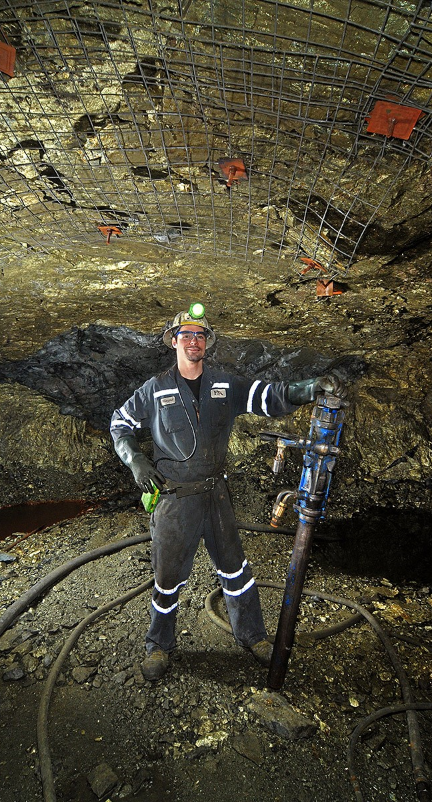
Levack Mine
Morrison Copper-PGE Footwall Deposit
Magna Mining COO Jeff Huffman in a footwall copper stope at McCreedy West in 2010
tCEO Jason Jessup and COO Jeff Huffman in a captive cut & fill stope in the Morrison Deposit in 2011
Morrison Deposit mechanized cut & fill stope circa 2010

Slide 17
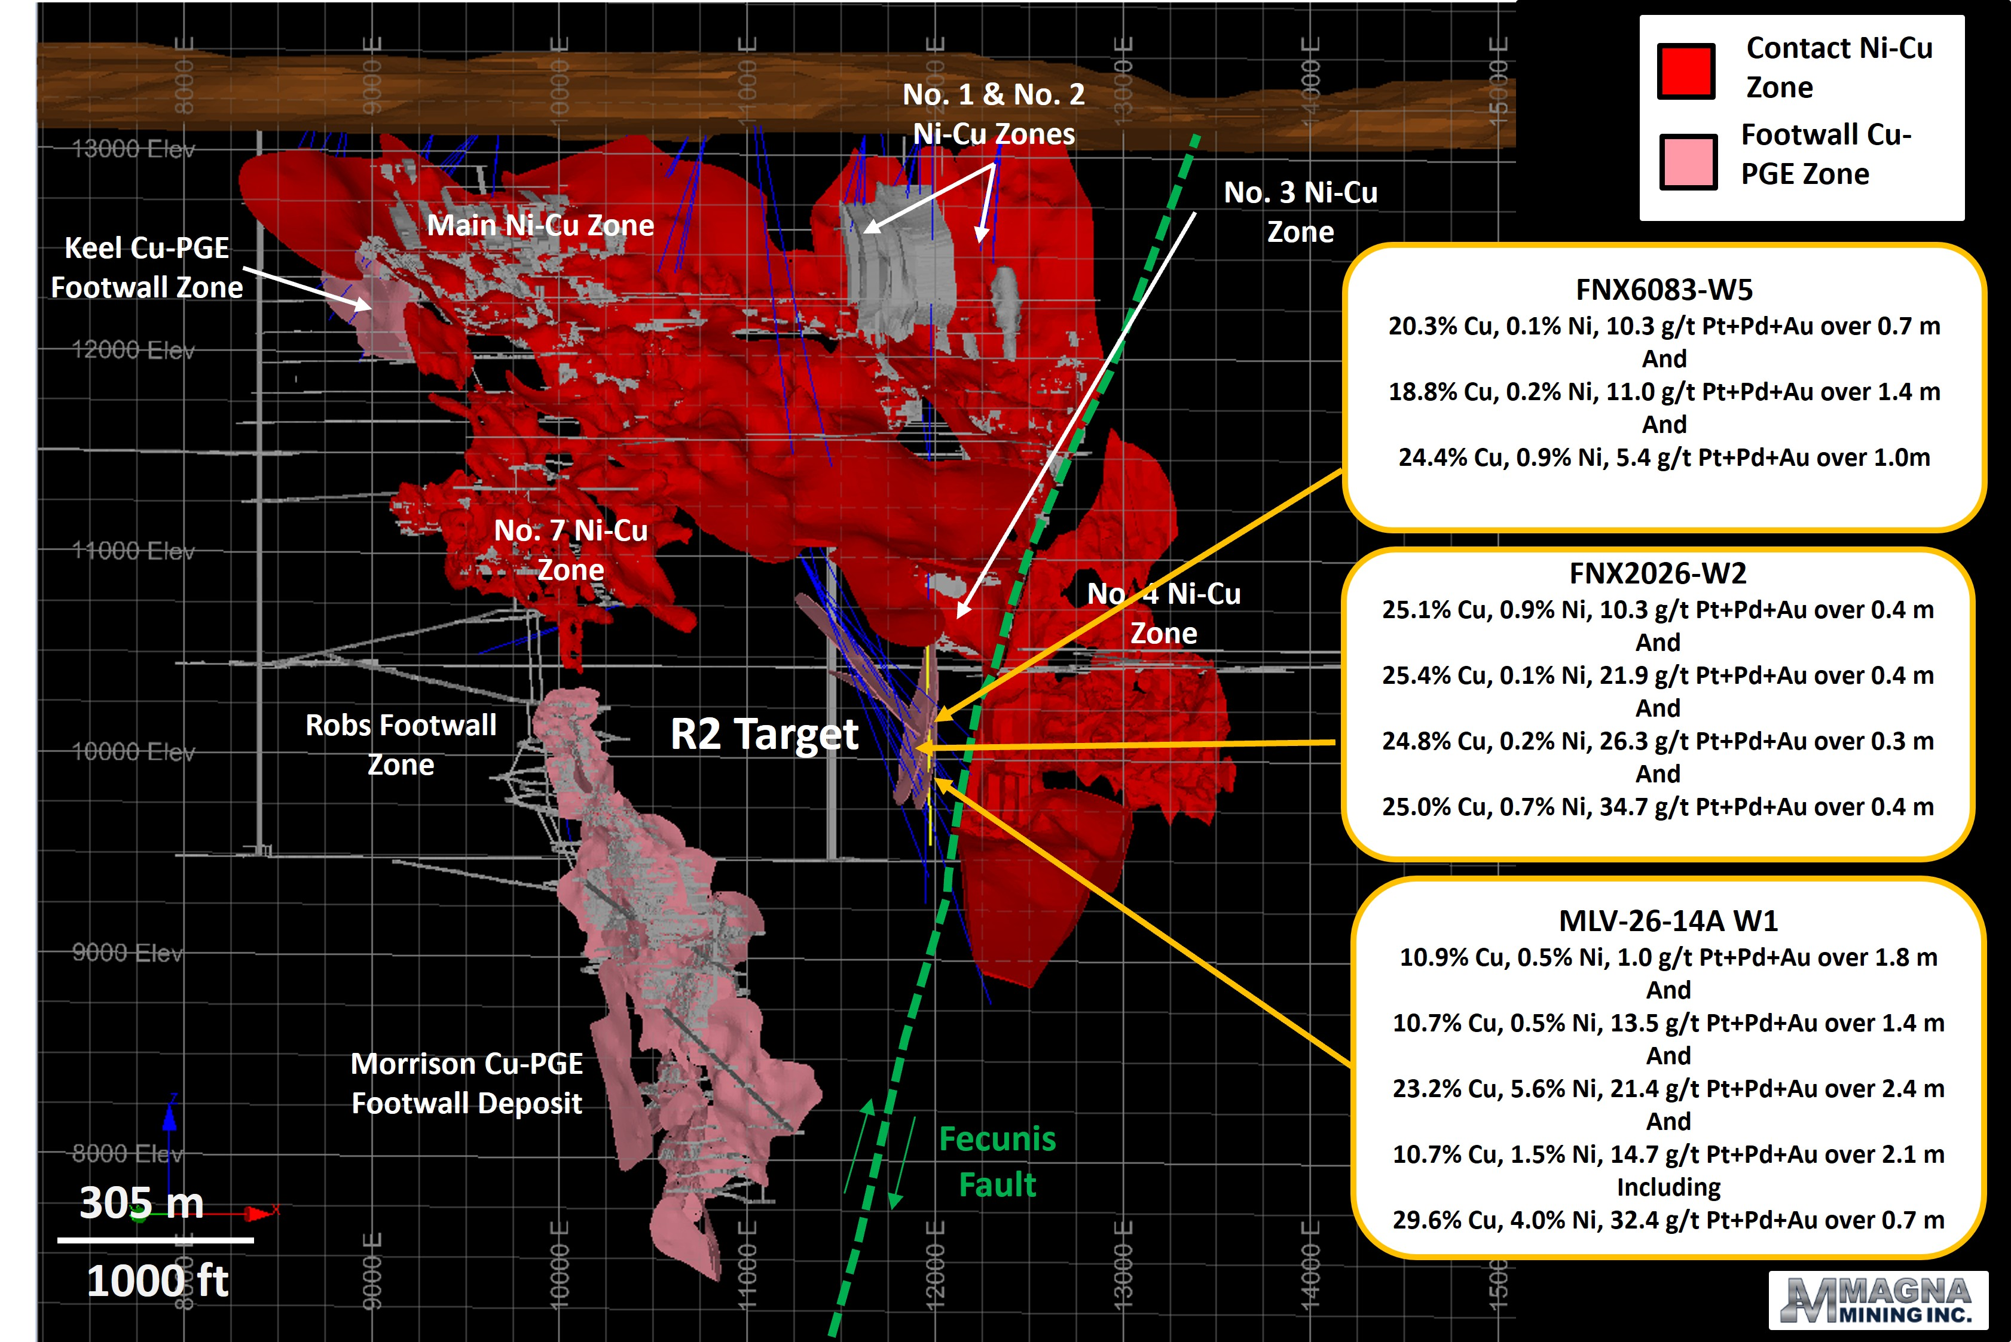
Levack Mine
R2 Footwall Zone
The R2 Footwall Zone area exhibits many mineralogical and structural similarities to the top of the adjacent Morrison Footwall Cu-PGE Deposit.
High nickel and PGE grades transition into very high-grade copper and precious metals.
Exploration is ongoing with two surface drill rigs and two underground drill rigs.
17

Slide 18
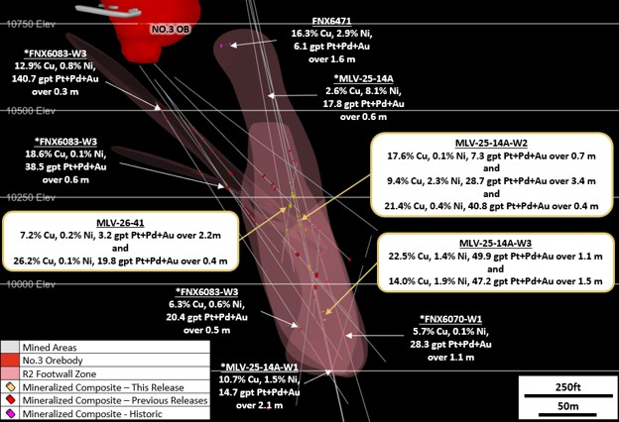
Levack Mine
R2 Footwall Zone
R2 Footwall Zone has been intersected over a vertical extent of approximately 300 metres and a north-south extent of approximately 150 metres
The R2 Footwall Zone remains open up dip towards the No. 3 Footwall Zone as well as at depth towards the Morrison Footwall Cu-PGE Deposit, located 600 metres to the southwest
18

Slide 19
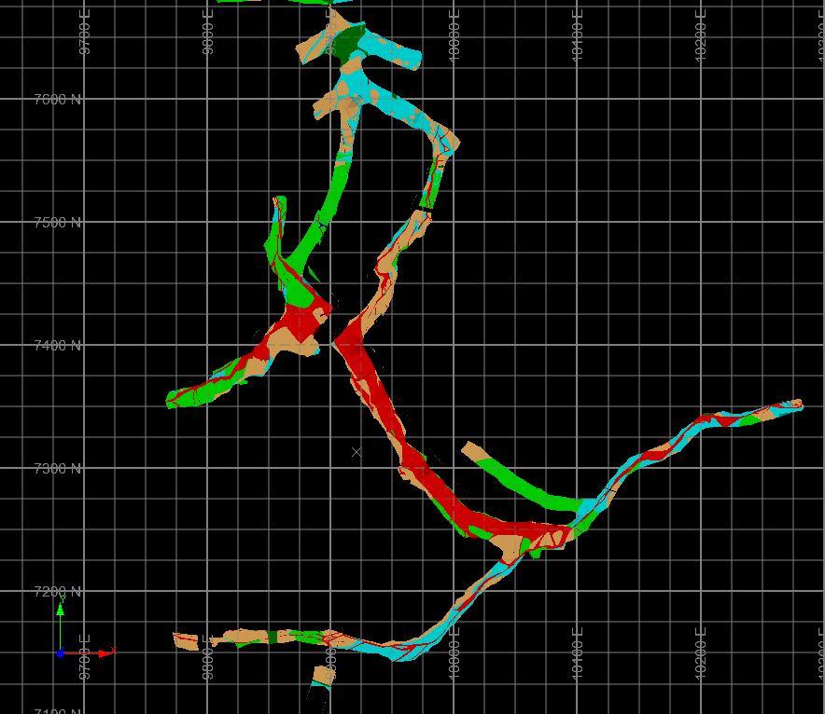
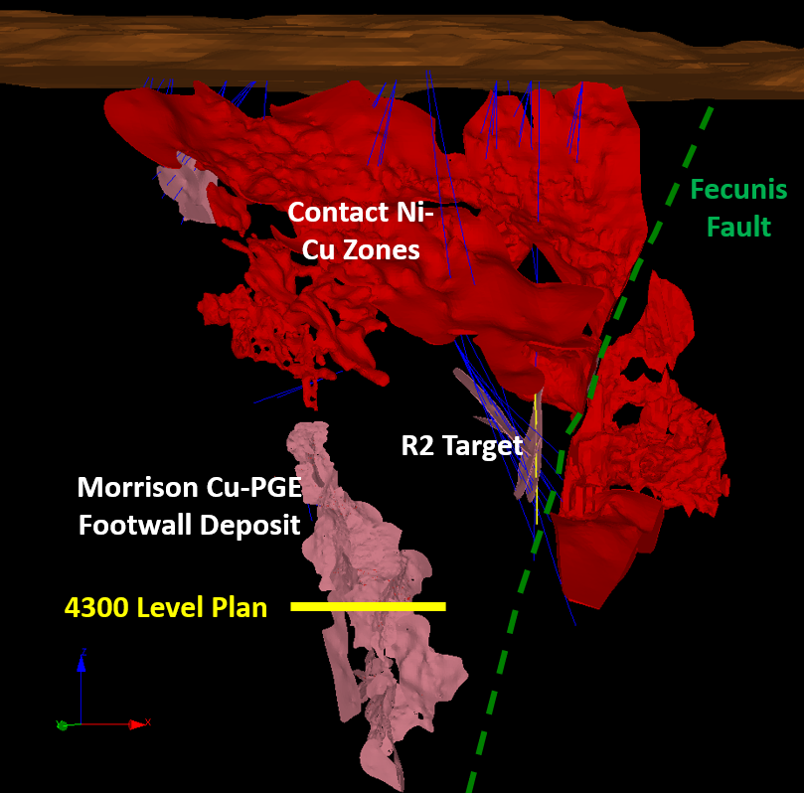
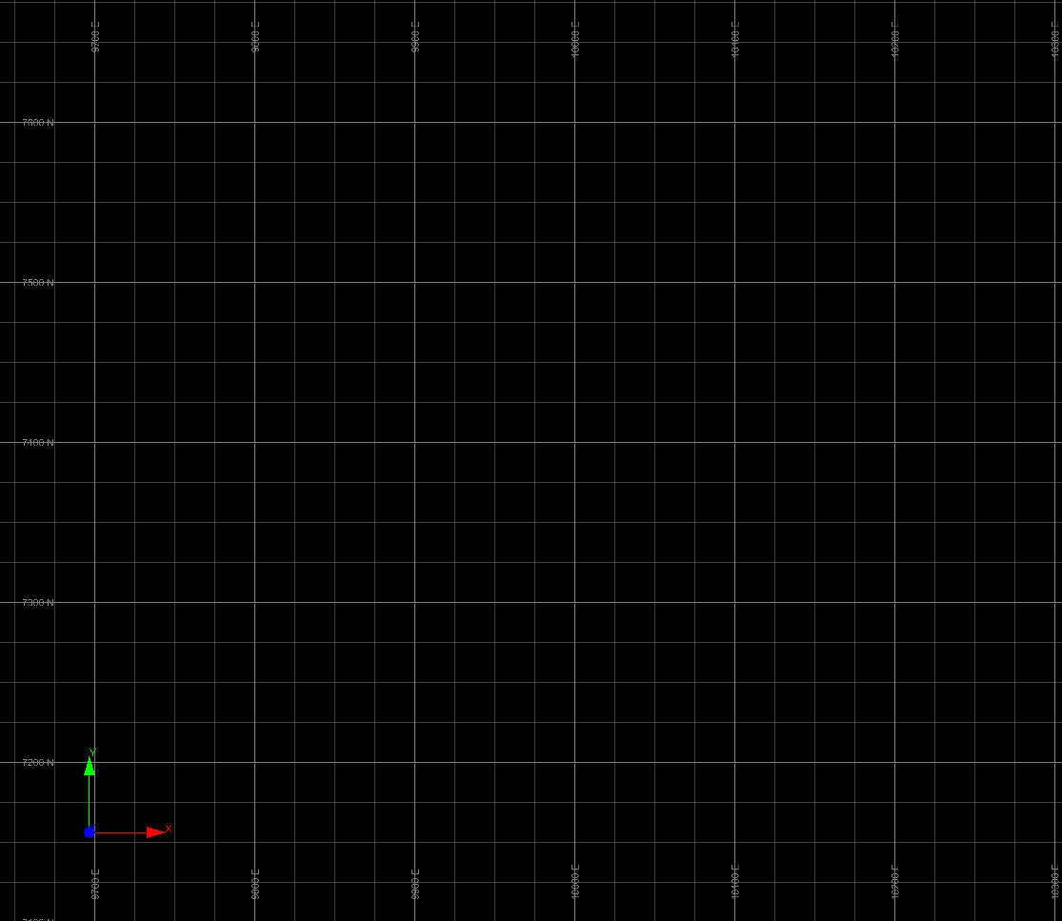
Levack Mine
Footwall Exploration Target Areas
Felsic Norite
Morrison 4300 Level Development Back Mapping
Morrison 4300 Level Sulphide Vein Schematic
Sublayer Norite
Granite Breccia
Sulphide Vein
Granite Gneiss
Mafic Gneiss
Sudbury Breccia
Narrow Sub-vertical veins
Gabbro
Narrow Sub-vertical veins
Narrow Sub-vertical veins
Narrow Sub-vertical veins
Structural Trend Towards R2
Thick Shallow Dipping veins
N
Thick Shallow Dipping veins
N
30 m
30 m
Narrow Sub-vertical veins
100 ft
Narrow Sub-vertical veins
100 ft
Recent drilling at R2 supports Magna’s structural model and interpreted similarities with the controlling structures within the Morrison Footwall Cu-PGE Deposit, located 600 metres to the southwest.
At the Morrison Deposit, more significant massive sulphide veins up several metres thick often occur in the extensional environment between the north-south striking bounding structures that contain narrower mineralized veins.
The mineralization in the R2 Footwall Zone may have similar controls, as demonstrated by the multiple veins encountered in drillhole MLV-26-14A W1 & W3 with downhole widths ranging from 0.7 – 3.4 metres.
19

Slide 20
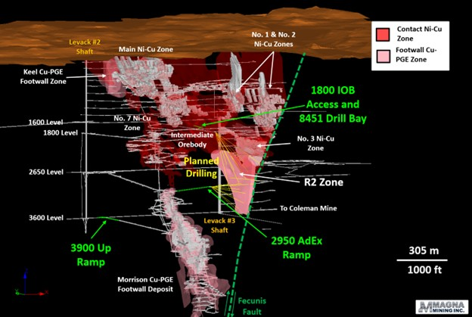
Levack Mine
Progress Update
Connection of 3900 Level ramp to 3600 Level complete, facilitating Coleman Mine secondary egress.
Development complete on the 1800 Level to access the Intermediate Ore Body (IOB).
Underground drilling of R2 Footwall Zone underway from 8451 Drill Bay on the 1800 Level.
R2 Advanced Exploration (AdEx) Ramp from 2950 Level of Morrison Deposit completed and drilling underway.
Rehabilitation of 2650 Level underway to accommodate drilling of R2 Footwall Zone.
20

Slide 21
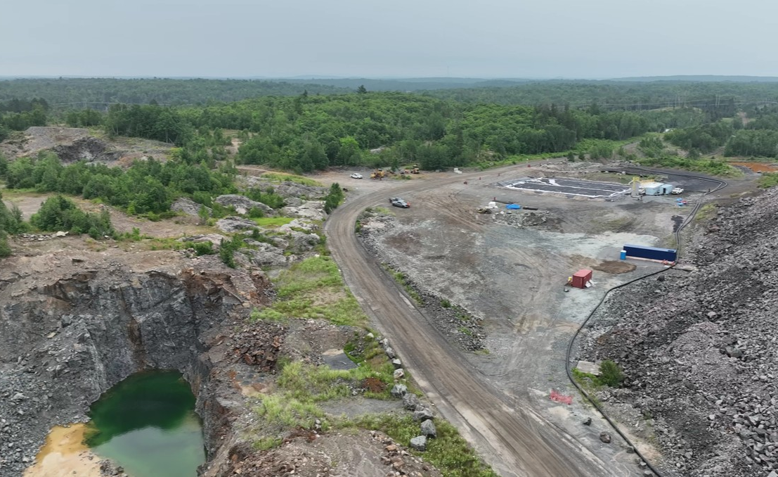
Crean Hill Mine
Past-Producing Nickel-Copper-Precious Metals Mine
Victoria Mine Project (KGHM)
Water Treatment Plant
Portal Location
Outcrop of 109 FW
Historical Main Pit (Filled)
Waste Rock Stockpile
2024 109 FW Bulk Sample Location
21
21

Slide 22
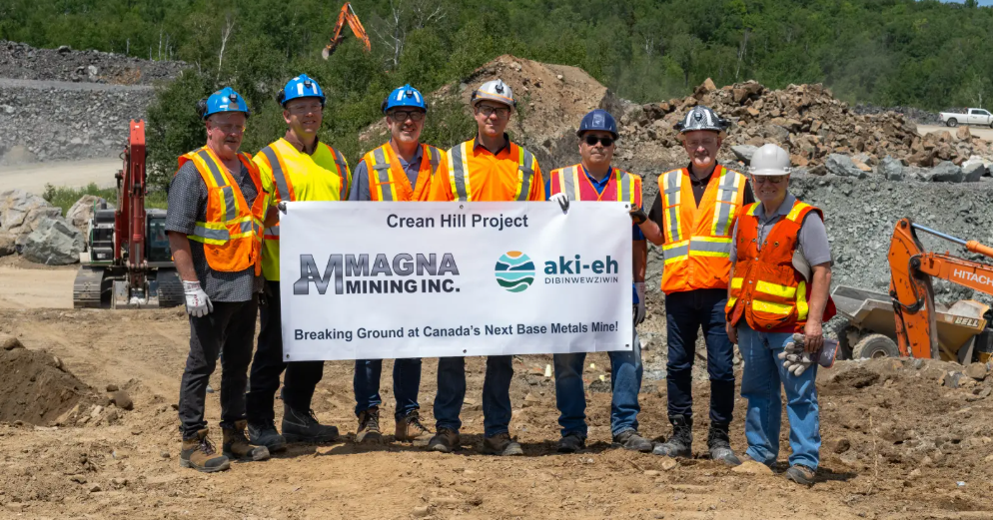
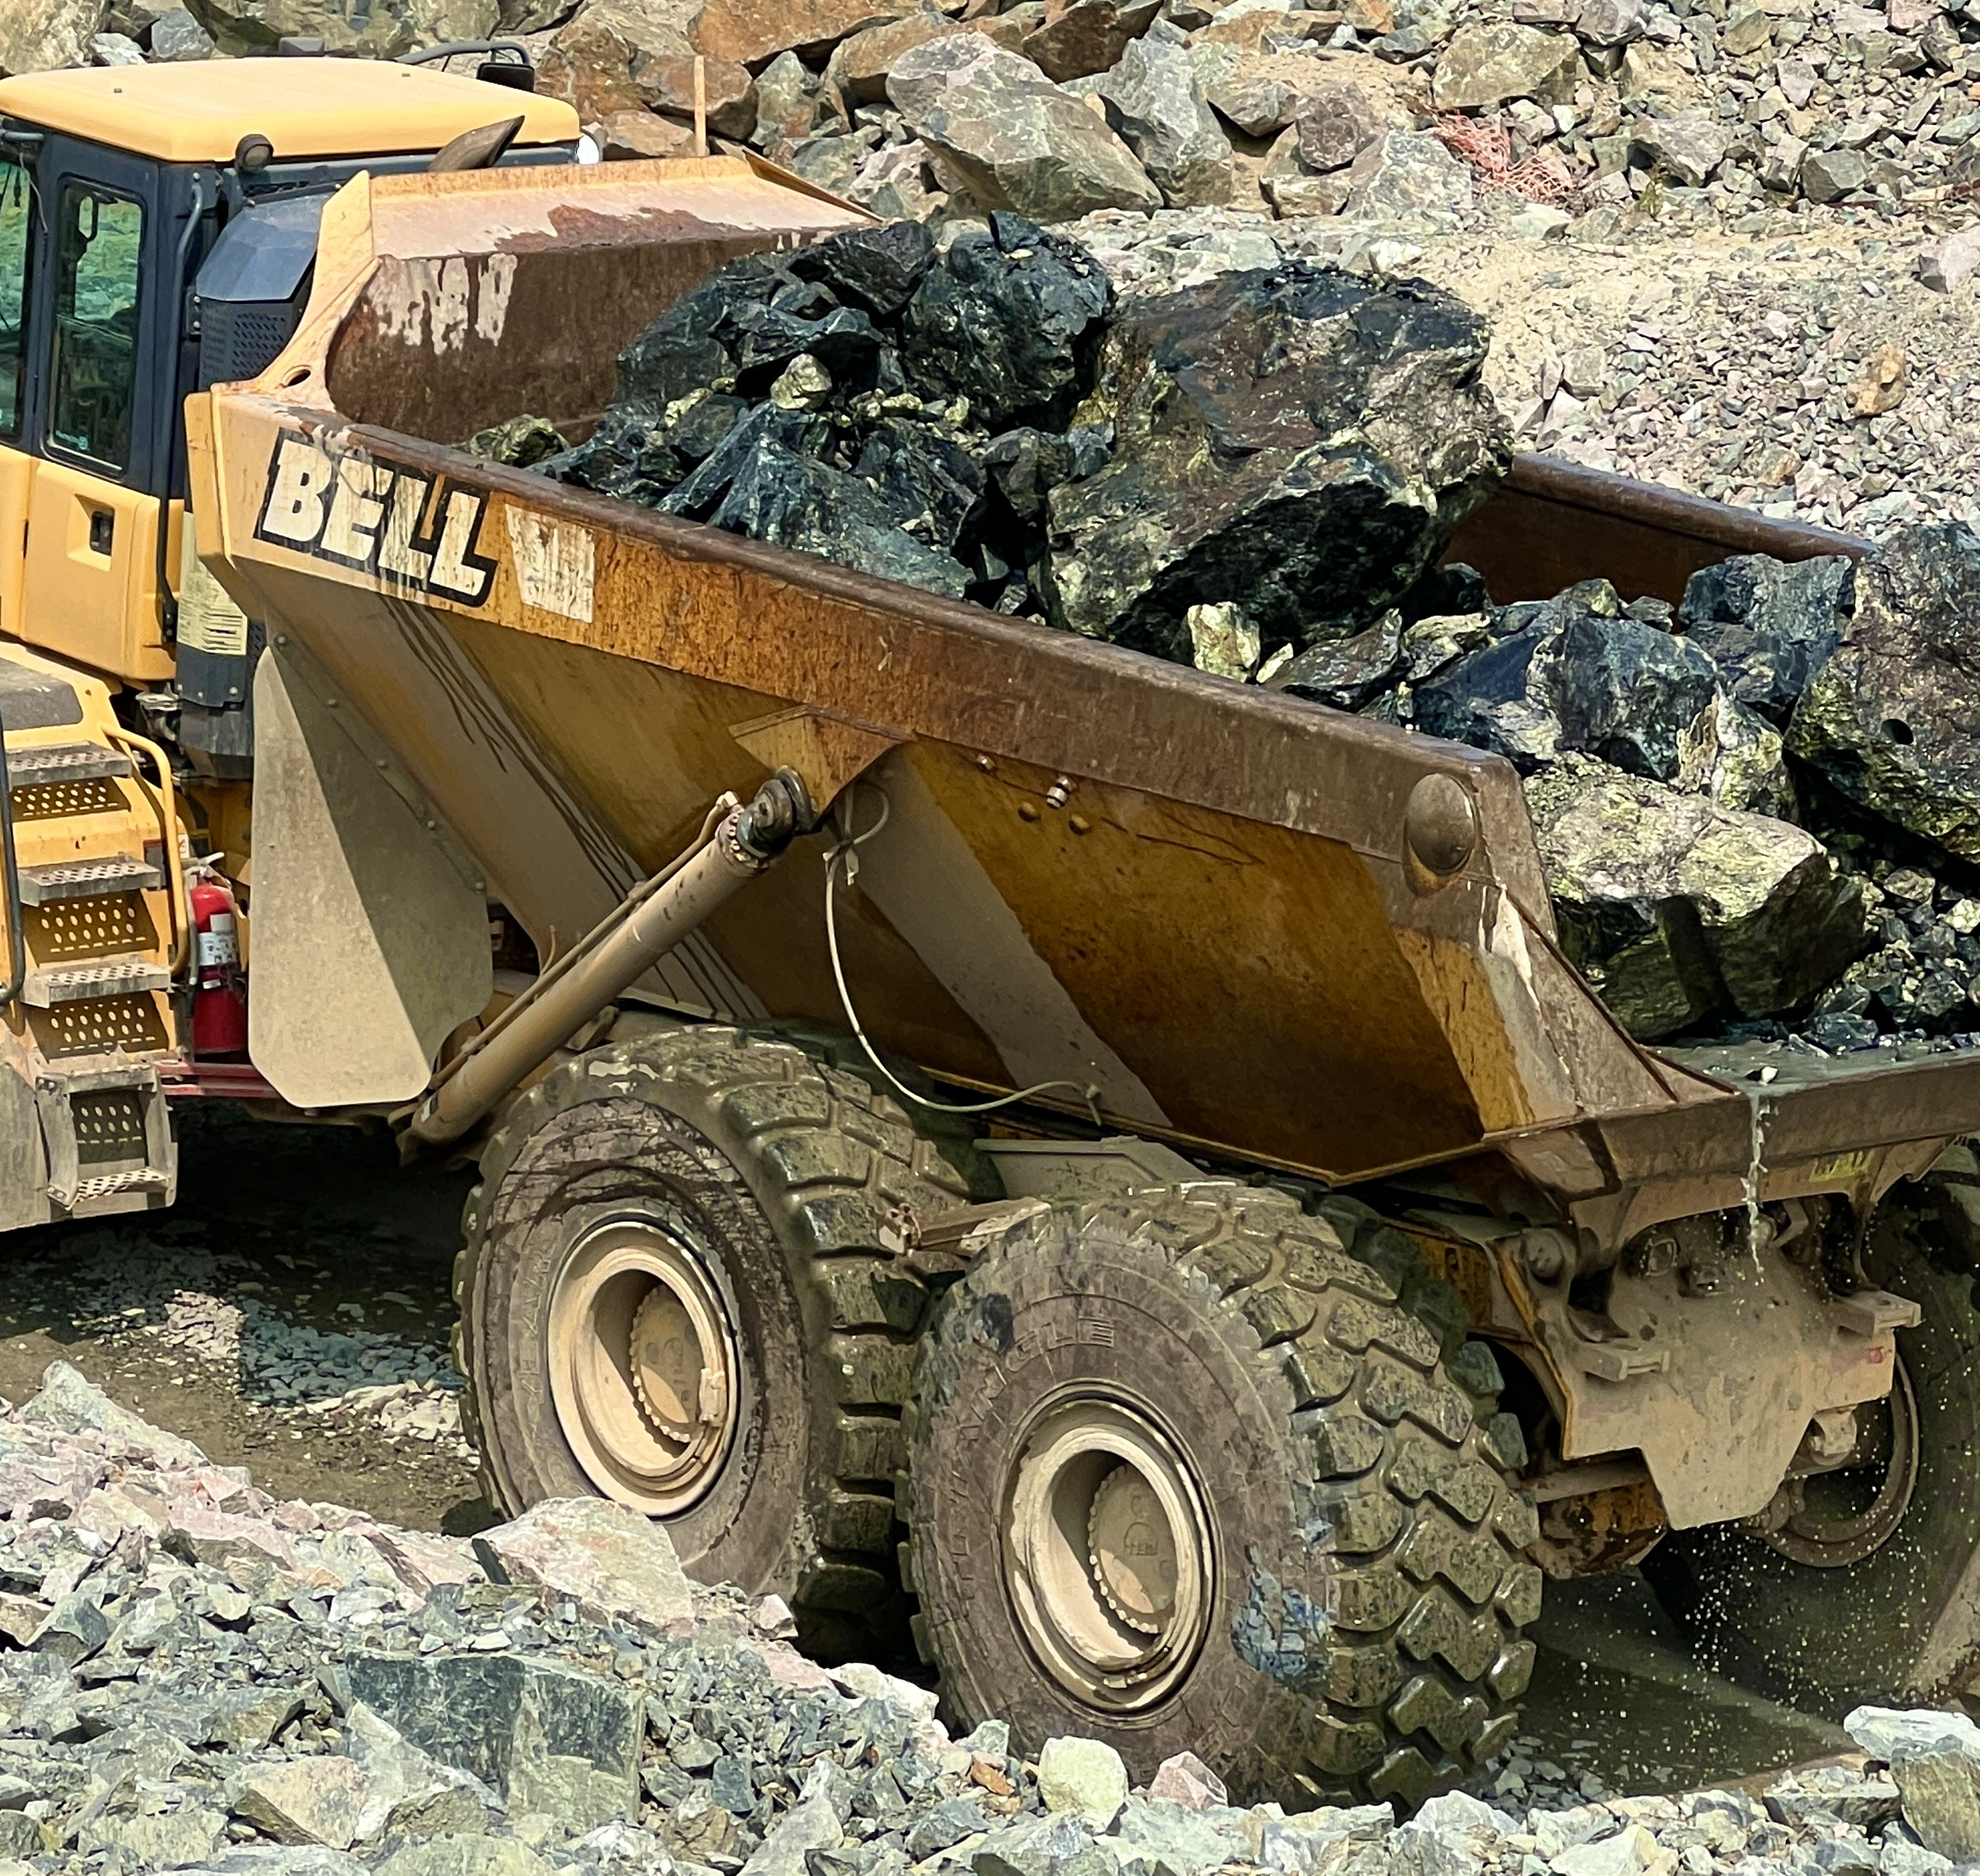
Crean Hill Mine
2024 Resource Estimate & PEA
Classification | Cut-off NiEq% | Tonnes (M) | Cu (%) | Ni (%) | Co (%) | Pt (g/t) | Pd (g/t) | Au (g/t) | NiEq (%)
Indicated | 1.1% | 18.444 | 0.87 | 1.01 | 0.035 | 0.98 | 1.12 | 0.37 | 1.96
Inferred | 1.1% | 0.989 | 0.53 | 0.70 | 0.026 | 0.98 | 1.66 | 0.29 | 1.56
2024 PEA Study:
2,200 tonnes per day, underground-only operation.
13 year mine life.
Modest capital costs for ADEX and Pre-Production periods are offset by revenues, resulting in total net capital costs of C$44.4m (net of revenues).
Pre-Tax IRR of 142%.
Short Payback period (1.5 years).
Confirmed processing terms with third party mills.
PFS underway with scheduled completion in October 2026
Crean Hill PEA - Spot Price Analysis
 | Nickel | Copper | Cobalt | Platinum | Palladium | Gold | TPM (Pt+Pd+Au)
PEA Price Deck | $8.50 | $4.00 | $13.00 | $900 | $1,000 | $2,150
Q2 2026 Average Price | $8.04 | $6.10 | $24.27 | $1,970 | $1,444 | $4,592
 | -5% | 53% | 87% | 119% | 44% | 114%
2024 PEA Price Deck % of Revenue | 51% | 26% | 1% | 7% | 9% | 7% | 23%
PEA 2024 Q2 2026 Prices % of Revenue | 37% | 29% | 1% | 11% | 11% | 10% | 32%

Slide 23
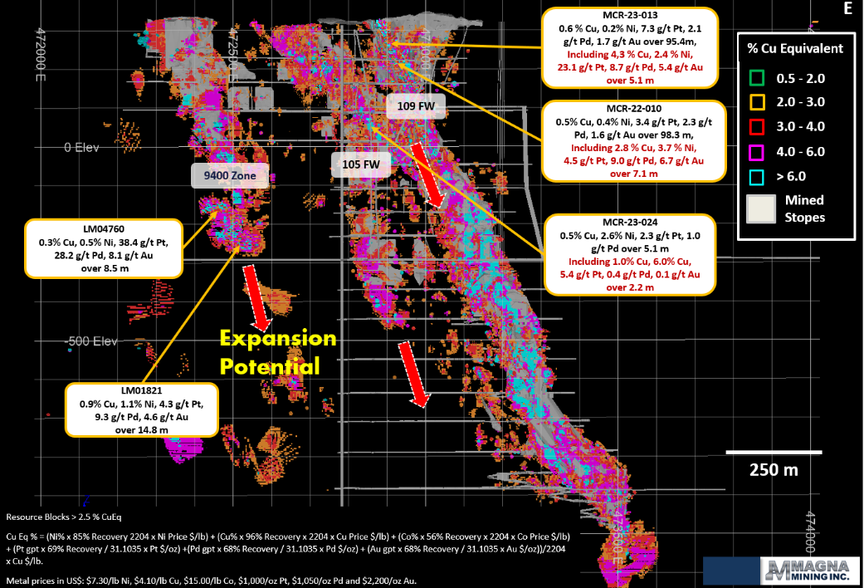
Crean Hill Mine
Mineral Resource Model
2024 PEA outlined a 13 year, 2,200 tonne per day operation with LOM mineable resource sales of 195.5 million pounds nickel, 169.5 million pounds copper, 313,000 oz platinum, 359,000 oz palladium, and 117,000 oz gold.
Pre-Feasibility Study underway with completion in October 2026.
23

Slide 24
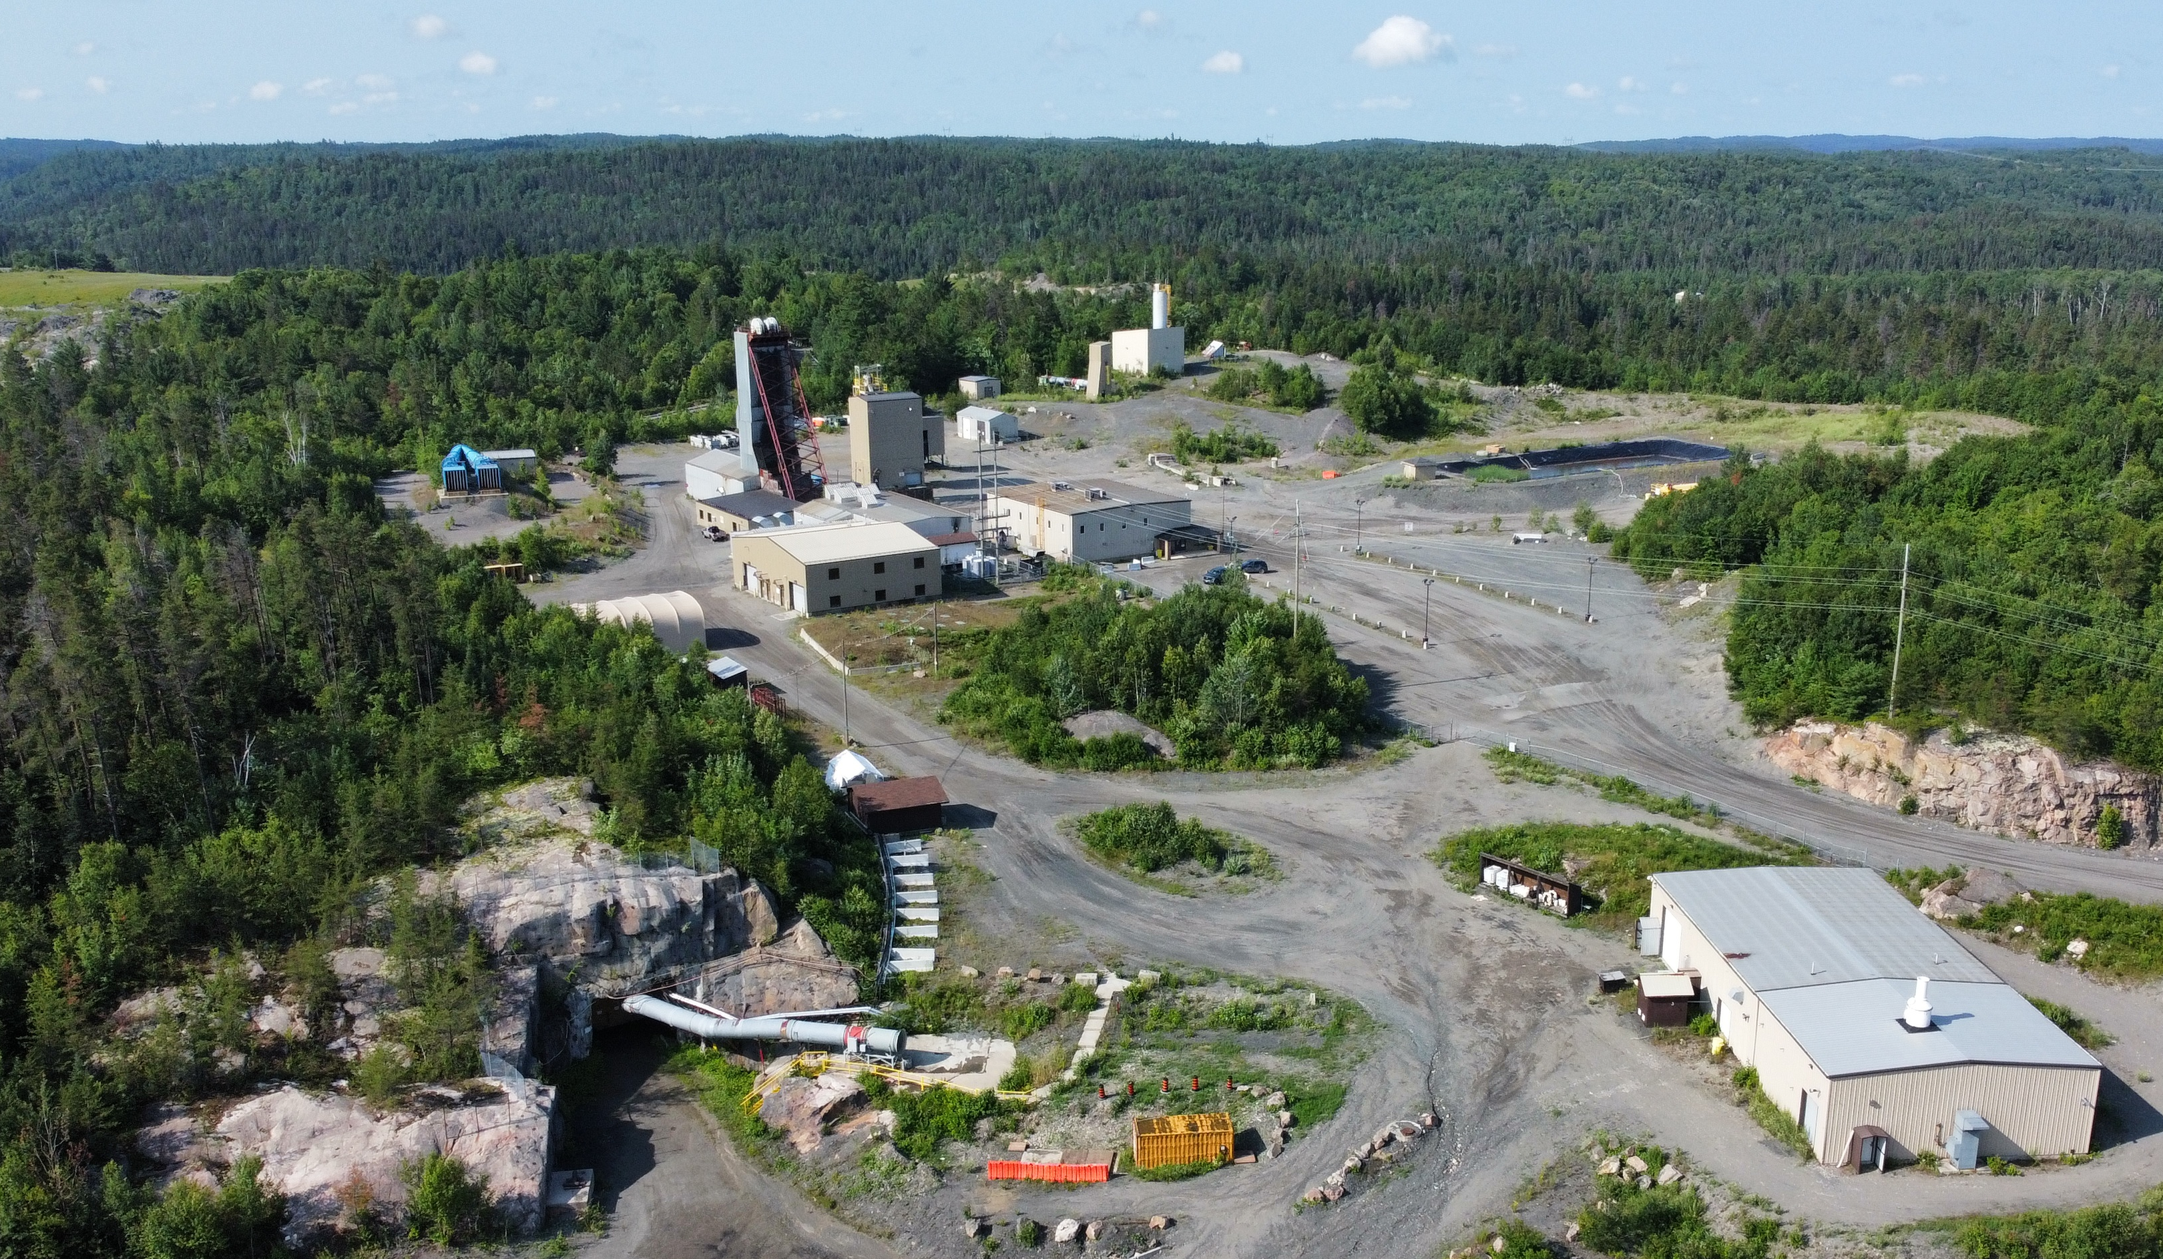
Podolsky Mine
Past-Producing Copper-Nickel-Precious Metals Mine
Administration Building
Security
2000 Deposit Shaft
Waste Water Treatment Plant
North Zone Portal
24
24

Slide 25
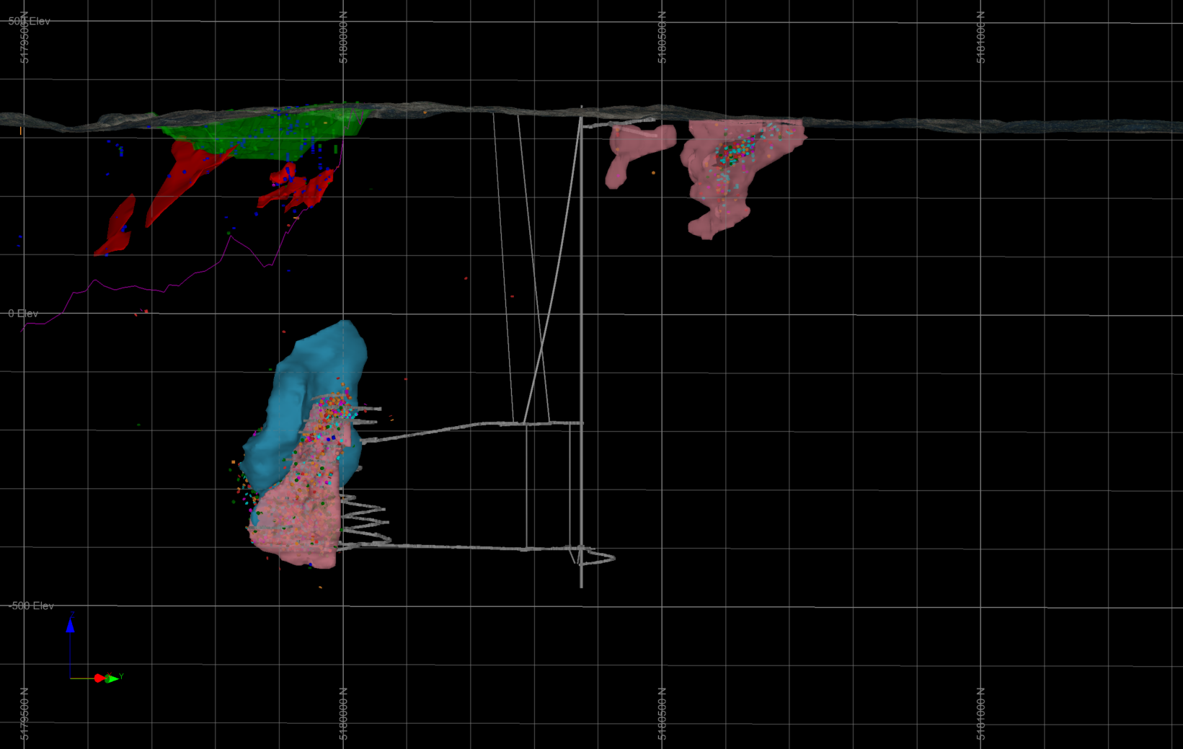
Podolsky Mine
Past-Producing Copper-Nickel-Precious Metals Mine
SW
NE
Whistle Pit
Main Shaft
Portal
North Zone
Contact
Ni Zones
FNX4199
17.8 % Cu, 1.4% Ni, 10.2 g/t Pt+Pd+Au over 7.0 m
FNX4400
1.0 Ni, 0.2% Cu, over 103.7 m
SIC Contact
Gabbro Zone
FNX4205
21.0 % Cu, 0.7% Ni, 15.9 g/t Pt+Pd+Au over 6.6 m
FNX40238
23.4 % Cu, 1.2% Ni, 12.9 g/t Pt+Pd+Au over 2.2 m
2450 level
2000 Zone
200m
25
Ramp exists to within 150 metres of the North Zone which is permitted for a bulk sample.

Slide 26
A Clear Pathway to Multi-Asset
Copper-Nickel-Precious Metals Production in Sudbury
EXPLORATION
&
ACQUISITION
OF OTHER ASSETS
PRODUCTION
PERMITTED, PAST-PRODUCING DEVELOPMENT PROJECTS
OTHER PROPERTIES
Increasing Copper Equivalent
Production
SHAKESPEARE
Permitted for a 4,500 tpd mill
PODOLSKY
Strategic existing shaft & ramp to North Zone
CREAN HILL
PFS completion in Fall 2026 followed by construction decision
LEVACK
PEA completion in Fall 2026 followed by production restart decision
McCREEDY WEST
Producing copper-nickel-precious metals mine
06

Slide 27
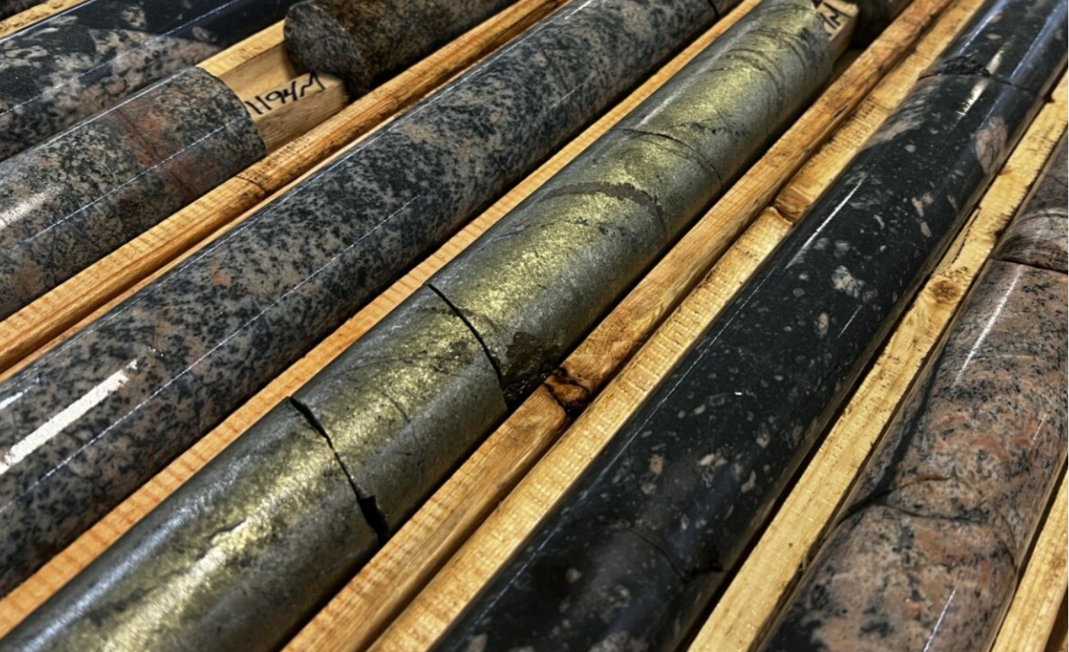

MAGNA MINING
Upcoming Catalysts
NEAR TERM LEVACK EXPLORATION RESULTS - FOOTWALL TARGETS
CONTINUED OPERATIONAL MOMENTUM AT McCREEDY WEST
LEVACK PEA & CREAN HILL PFS IN OCTOBER 2026 + RE-START DECISIONS
POTENTIAL SYNERGISTIC ACQUISITIONS
27

Slide 28
MAGNA MINING
Summary
McCreedy West Mine operational improvements leading to improved cash flow
Levack Mine re-start preparations well underway, funded by cash flow and cash on hand
Continued exploration success at Levack with the new R2 Footwall Zone taking shape with underground rehabilitation and development providing optimal platforms for delineation drilling
Results from the Levack PEA and Crean Hill PFS in October 2026 to inform the Company-wide, multi-year production profile
Graduated to the Toronto Stock Exchange (TSX) as of June 23, 2026
$140 million strategic investment by Alpayana for a 19.9% equity stake
Well-funded with ~$175 million in cash and cash equivalents*
Sudbury-focused M&A continues to be a key focus
28
* Cash & cash equivalents as of Q2 2026 Financial Statements plus the net proceeds from the C$140 million strategic investment by Alpayana which closed on August 28, 2026.

Slide 29
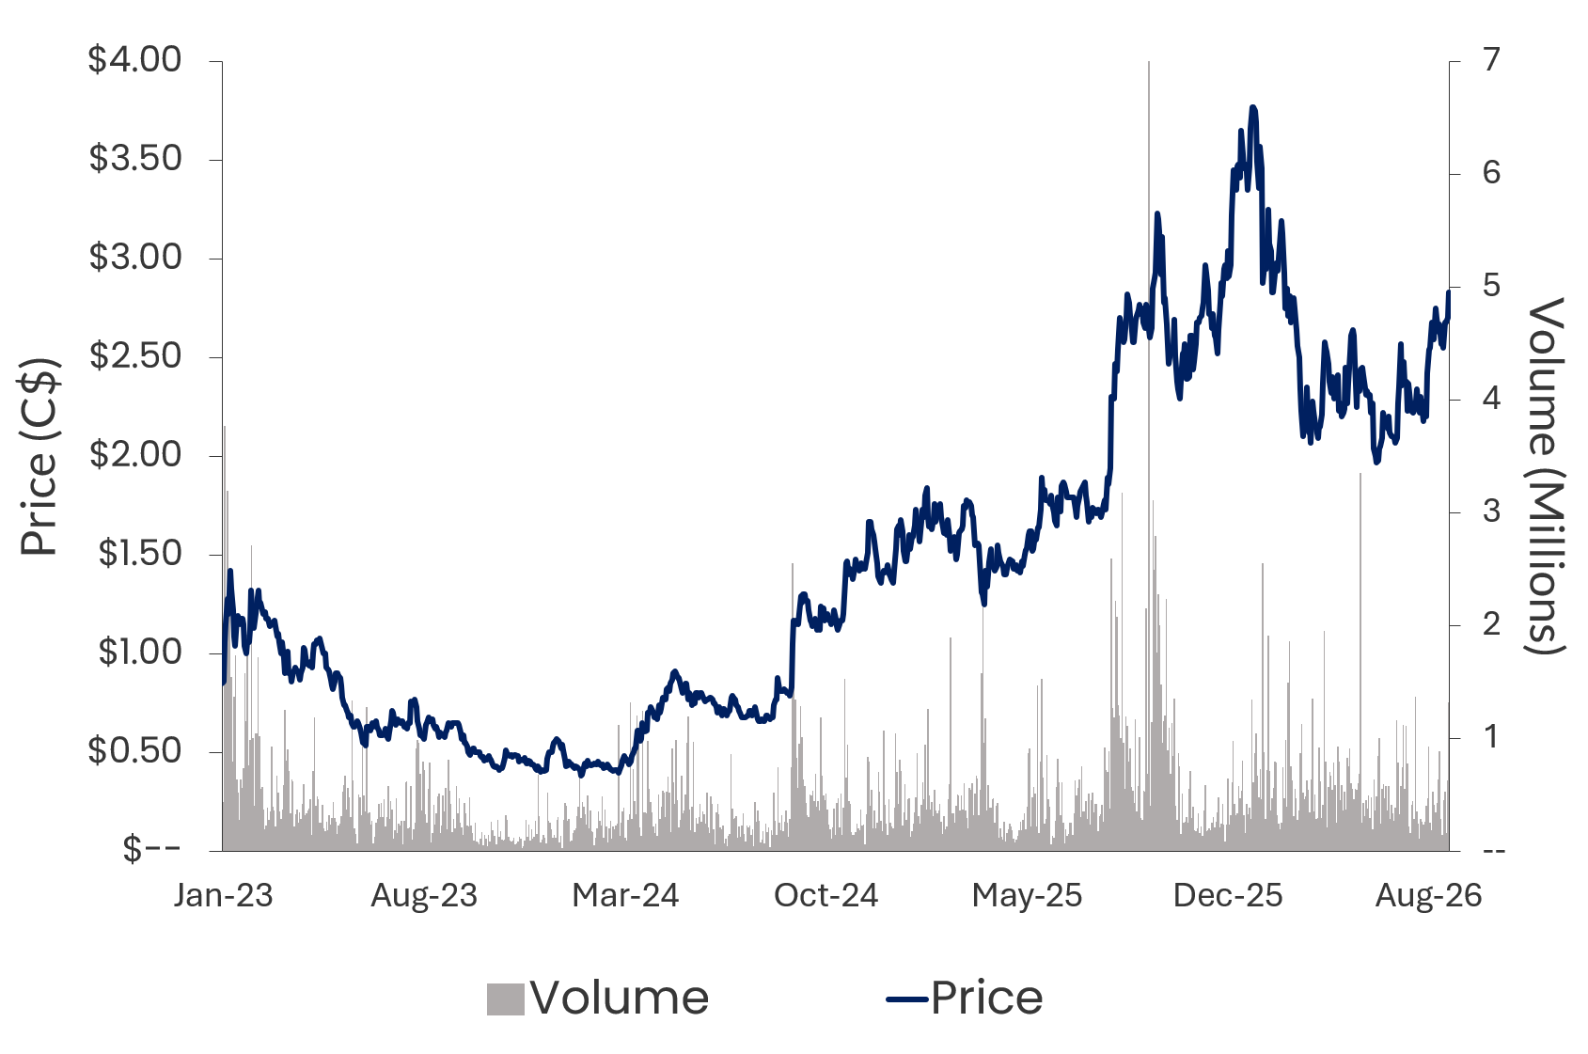
MAGNA MINING
Capital Structure
Issued & Outstanding | 313,451,861
Options, RSUs & DSUs | 14,177,470
Warrants | 0
Fully Diluted | 327,629,331
Cash¹ | C$40.0 million
Debt² | C$24.0 million
Share Price³ | C$2.49
Market Capitalization (Basic) | C$780 million
EQUITY PERFORMANCE
(TSX: NICU)
CURRENT CAPITAL STRUCTURE
¹ As of Q2 2026 Financial Statements. Does not include net proceeds from the C$140 million strategic investment by Alpayana which closed on August 28, 2026.
² C$23,967,000 of Convertible notes outstanding, March 2029. Not including $25 million letter of credit with Desjardins for closure liabilities, with $10.8 million outstanding.
³As of market close on October 2, 2026.
Canaccord Genuity | Dalton Baretto
Desjardins Capital Markets | Bryce Adams
Paradigm Capital | David Davidson
SCP Resource Finance | Eleanor Magdzinski
Alpayana | 19.9%
Institutional Investors including Dundee Corporation at 16.0% | 47.4%
Retail Investors | 26.9%
Management & Directors | 5.8%
ANALYST COVERAGE
SHAREHOLDER BASE
29

Slide 30
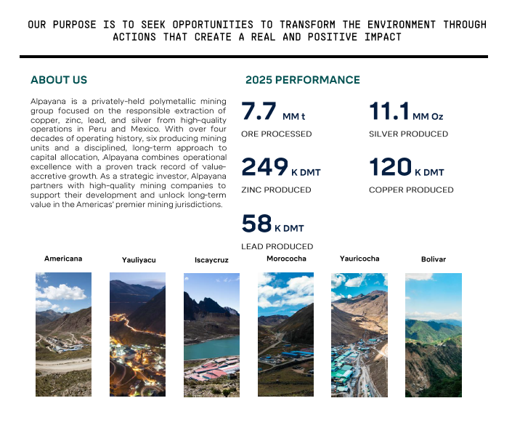
ALPAYANA
New Strategic Investor
Four decades of operating history and 6 producing underground mines in Peru and Mexico.
Alpayana invested C$140 million for a 19.9% stake in Magna Mining.
Significant polymetallic operating expertise; over 7 million tonnes of ore produced in 2025 across multiple operations.
Alignment of core values.
30

Slide 31
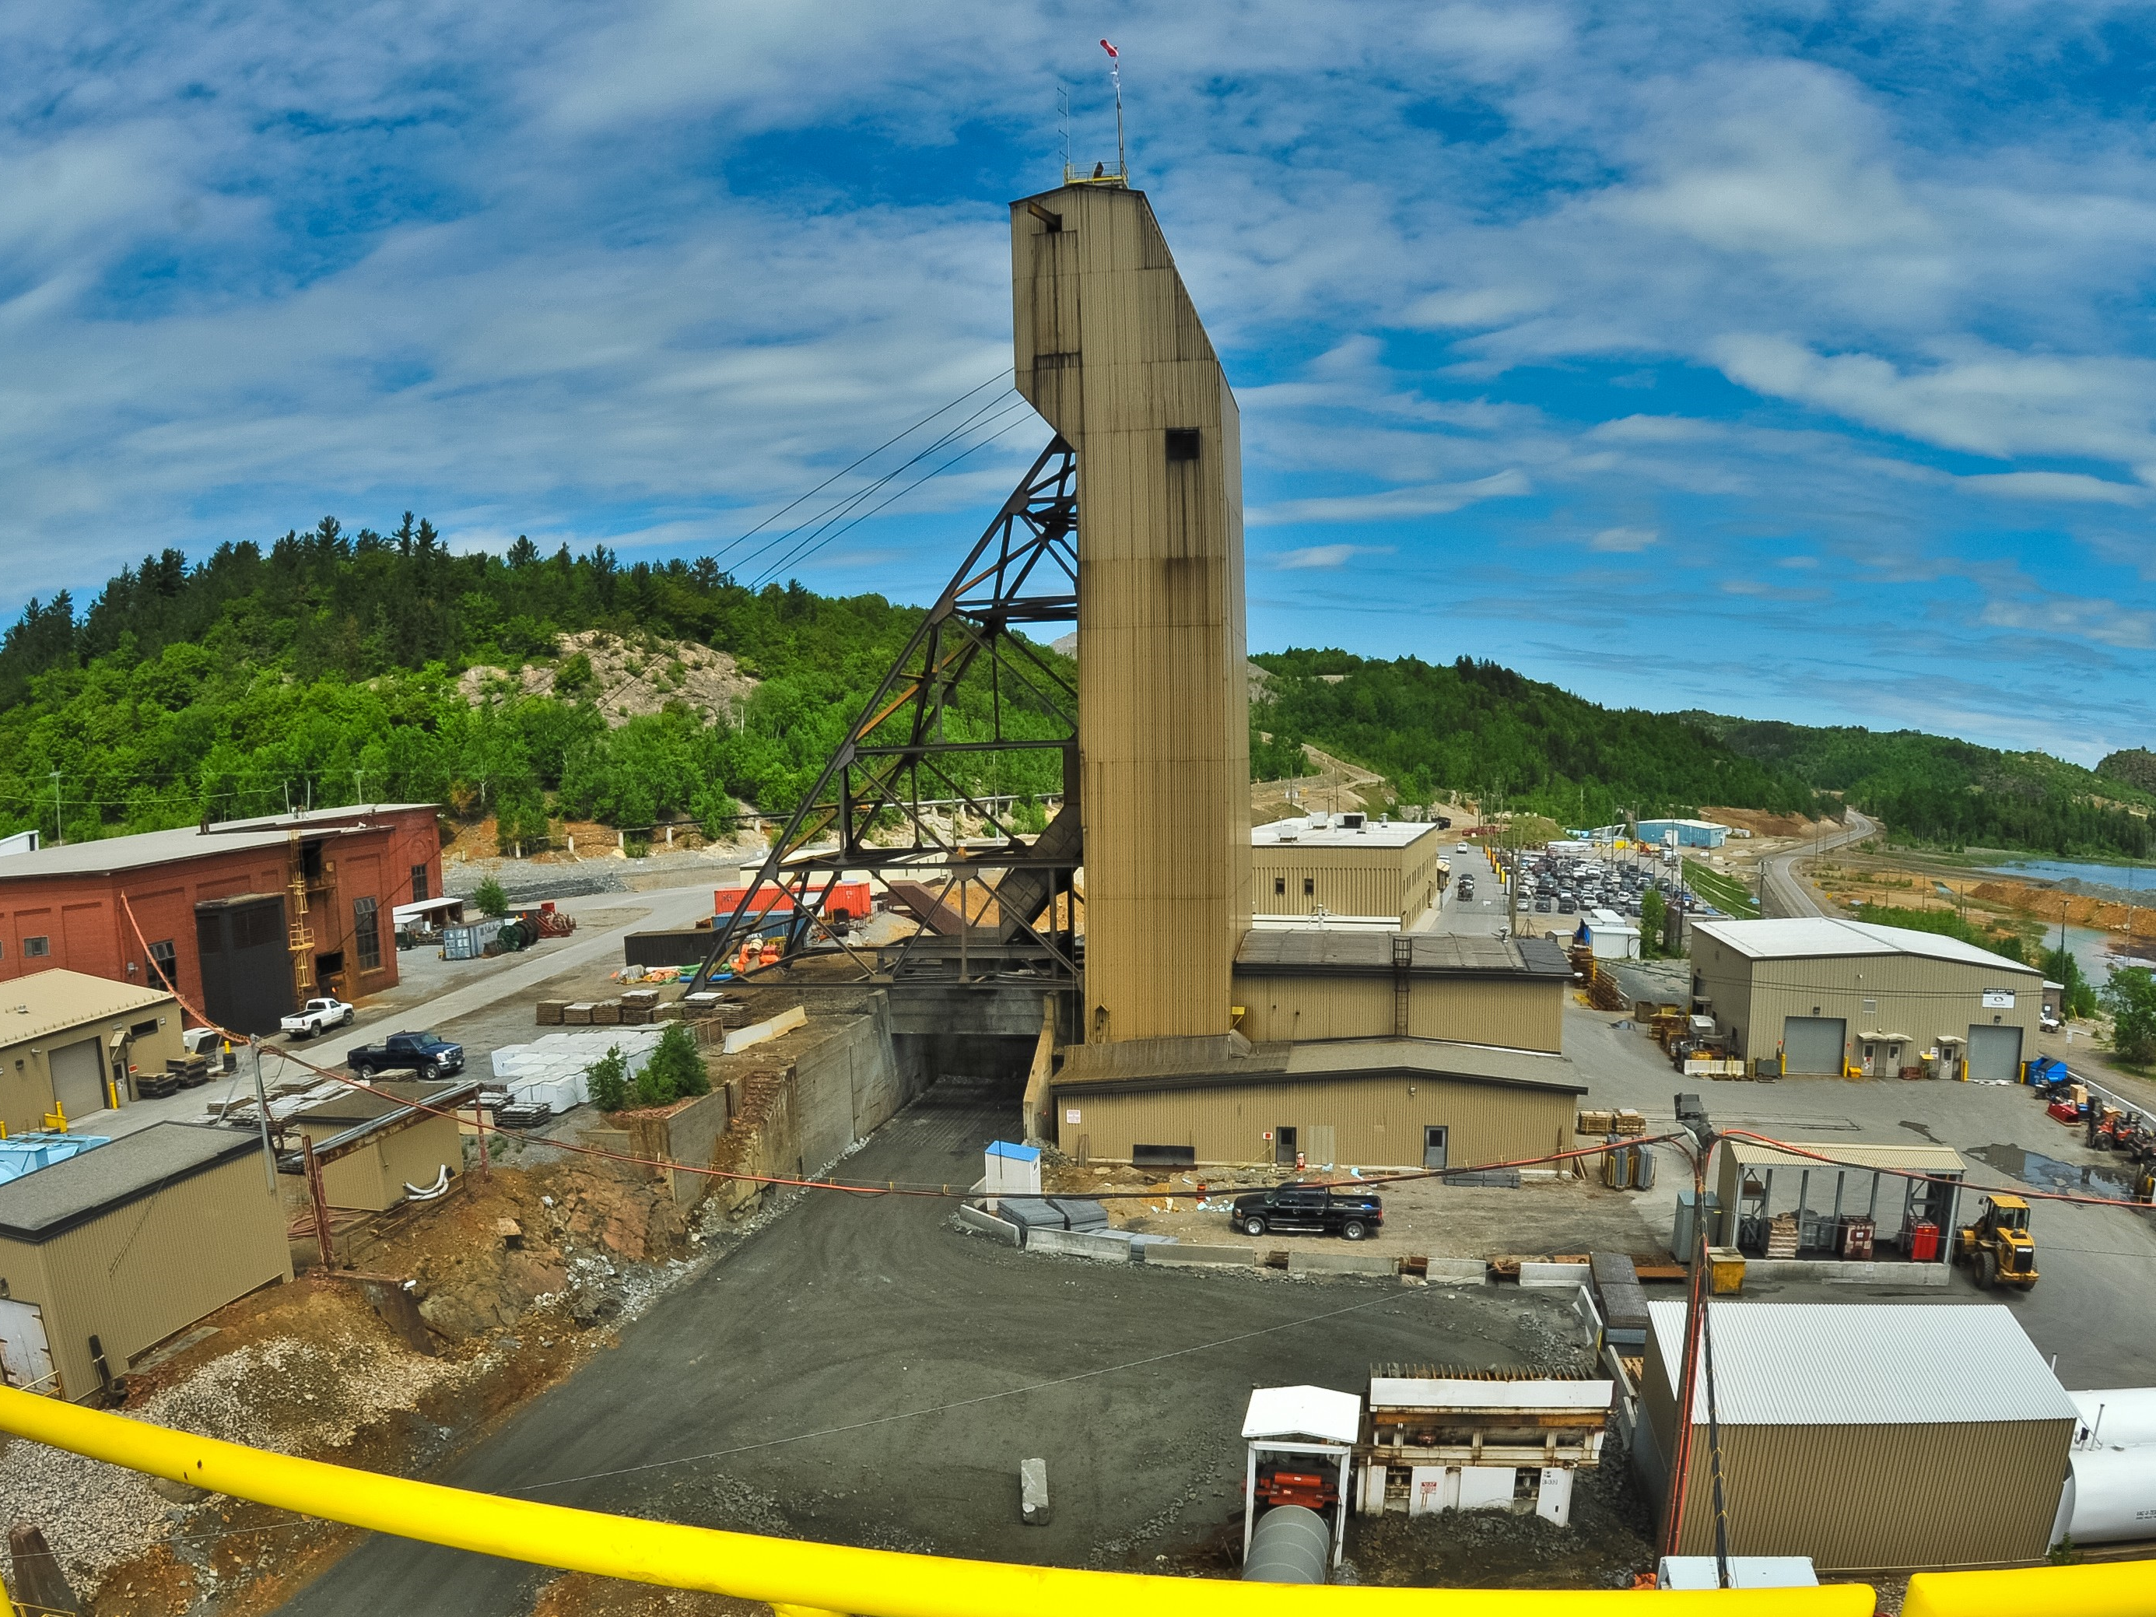




SUDBURY’S CANADIAN MINING COMPANY
TSX: NICU
OTCQX: MGMNF
www.magnamining.com
Jason Jessup, CEO
Jason.Jessup@magnamining.com
Paul Fowler, Executive Vice President
Paul.Fowler@magnamining.com

Slide 32







MAGNA MINING
Leadership
Jason Jessup, MBA – Chief Executive Officer & Director
Jason has over 25 years of experience in the mining industry comprising operations management, corporate development and project evaluation. Formerly FNX Mining, Sandstorm Gold, Premier Royalty, and INCO.
Paul Fowler, CFA – Executive Vice President
Paul is an experienced Mining Executive and has worked with publicly-listed Canadian mining companies for over 20 years. He has extensive experience in Corporate Development, Marketing, M&A, & Capital Raising, and most recently worked in Corporate Development roles for Reunion Gold and Benz Mining.
Jeff Huffman, MBA, PMP – Chief Operating Officer
Jeff is an experienced mining executive with over 20 years in operations management, project management and underground mine building. Jeff most recently served as President & COO of Dumas Contracting Ltd., a well-recognized, international underground mine contracting company. Jeff is a graduate of the Haileybury School of Mines, received his MBA from Athabasca University and is a registered Project Management Professional (PMP).
David King, M.Sc., P.Geo. - Senior Vice President, Exploration & Geoscience
David is a registered professional geologist with more than 25 years of base and precious metal experience, focused on both mining production and exploration. Mr. King most recently served as Vice President, Exploration and Geoscience for TMAC Resources Inc, and prior to that was Senior Manager, Geoscience and Mineral Resources of KGHM International Ltd (previously FNX Mining Company).
Scott Gilbert, CA, CPA, CBV – Chief Financial Officer
Scott has over 25 years of experience in finance roles in the mining sector. He most recently held the position of Chief Financial Officer at Wesdome Gold Mines Ltd., where he was responsible for all accounting functions, reporting, business strategy and risk management. Mr. Gilbert is a Chartered Professional Accountant and holds a Bachelor of Business Administration Degree from Lakehead University with a major in accounting.
Tim Bradburn, JD – Senior Vice President, General Counsel
Tim has 25 years as a corporate, securities and M&A lawyer for publicly traded, exchange-listed companies, including almost 20 years in the mining industry. He was most recently the Senior Vice President, General Counsel and Corporate Secretary for IAMGOLD.
Greg Huffman, B.Sc. – Senior Vice President, Capital Markets
Greg has over 20 years of capital markets experience in the mining sector, spanning positions in institutional mining equity sales, fund management, and mining equity research. Greg holds a B.Sc. in Earth Sciences (Geology) from the Harquail School of Earth Sciences at Laurentian University in Sudbury, Ontario.
32

Slide 33
MAGNA MINING
Directors and Strategic Advisors
Vern Baker, P.Eng., MBA Chairman
Vern has over 30 years of experience in the mining sector. He is currently the COO of Exiro Nickel and the former CEO of Jaguar Mining (TSX). Previously served as General Manager of Goldcorp’s Cerro Negro Mine, VP Operations at FNX Mining, and President of Duluth Metals.
Jonathan Goodman, Director
Jonathan has over 30 years mining investment and operating experience and has built extensive relationships in the global mining resource and finance sectors over a distinguished career. Jonathan held the role of Executive Chairman of DPM Metals (TSX:DPM) from April 2013 to September 2017, at which time he was appointed Chairman, and was its CEO from 1995 to 2013. Mr. Goodman is the President and CEO of Dundee Corporation.
Carl DeLuca, Director
Carl has extensive legal, public company and corporate governance experience. He is currently General Counsel and Corporate Secretary of Hemlo Mining Corp. (TSXV: HMMC). He previously served as General Counsel of Li-Cycle Holdings Corp., an NYSE-listed EV battery recycling company, and as General Counsel Detour Gold Corporation, a TSX-listed gold producer. He also held various roles at Vale Base Metals, including Head of Legal for North American & U.K. Operations. Mr. DeLuca started his career in private practice, in Toronto and New York. He holds his LL.B. from the University of Windsor, an H.B.A. from the Ivey School of Business at Western University, and a B.A. from Huron University College.
John Seaman, ICD.D Director
John is an executive with over 28 years experience in the mining industry, from exploration through development and production. He is currently a Director of various small cap companies was previously a director of i-80 Gold Corp, and Lead Director of Premier Gold Mines (PG:TSX). John served as the CFO of Premier Gold Mines from 2006-2012 and CFO of Wolfden Resources from 2002 to 2007. John is an ICD.D member of the Institute of Corporate Directors.
Gord Morrison, Advisor
Gord is a Canadian geologist and 2026 Canadian Mining Hall of Fame inductee with a 55-year record of transforming global mineral exploration. A premier authority on the Sudbury Basin, his visionary leadership guided teams to 17 major discoveries, yielding nine producing mines and four advanced development projects. His trademark methodology relies on an agile "learn and adjust" philosophy. By systematically building on historical data and aggressively challenging legacy assumptions, as well as fostering a commitment to cross-disciplinary teamwork, he guides teams to unlock the maximum potential wealth from their company assets.
33

Slide 34
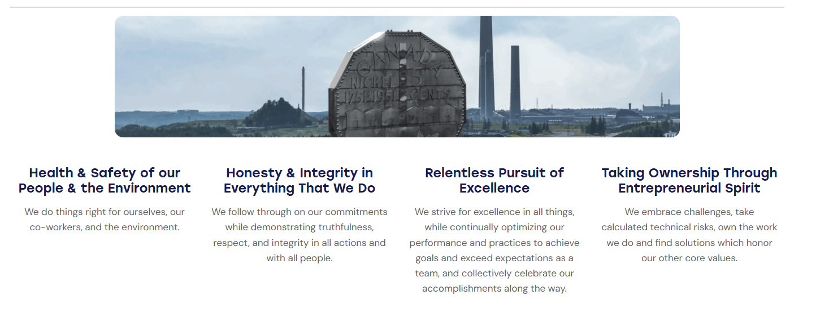
MAGNA MINING
Our Core Values
34

Slide 35

SUDBURY
Property Portfolio
~200km to
Timmins
RAND
NORTHWEST FOY
PARKIN
NORTH RANGE
PODOLSKY
LEVACK
FROST LAKE
Capreol
BLEZARD
Glencore
Strathcona Mill
KIRKWOOD
McCREEDY WEST
Levack
Glencore Falconbridge Smelter
Chelmsford
FALCONBRIDGE FOOTWALL
TRILL
Vale Clarabelle Mill
SHAKESPEARE
Vale Copper Cliff Smelter
City of Sudbury
Whitefish
Wanup
Key
Nairn
Producing Mine
CREAN HILL
Permitted Mine
Exploration Property
Massey
CREIGHTON SOUTH
~400km to
Toronto
Vale, Glencore and Magna Mining are the only three companies to have significant property holdings in the Sudbury Basin.
234

Slide 36
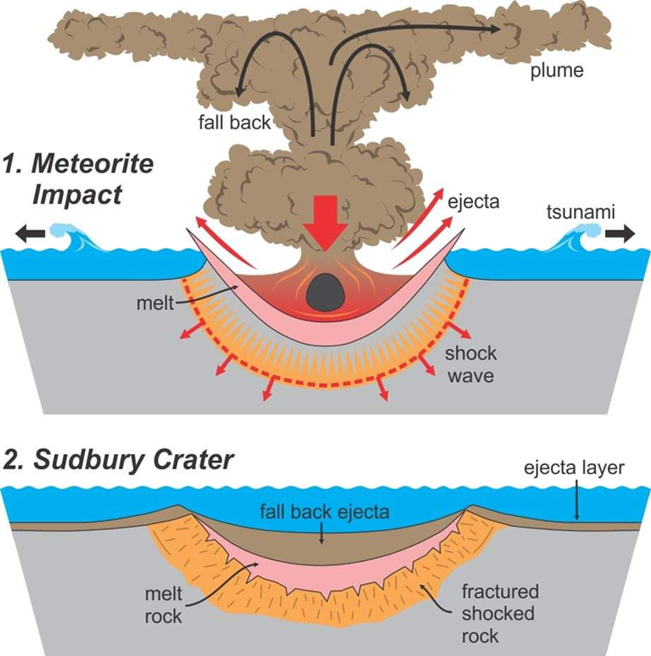
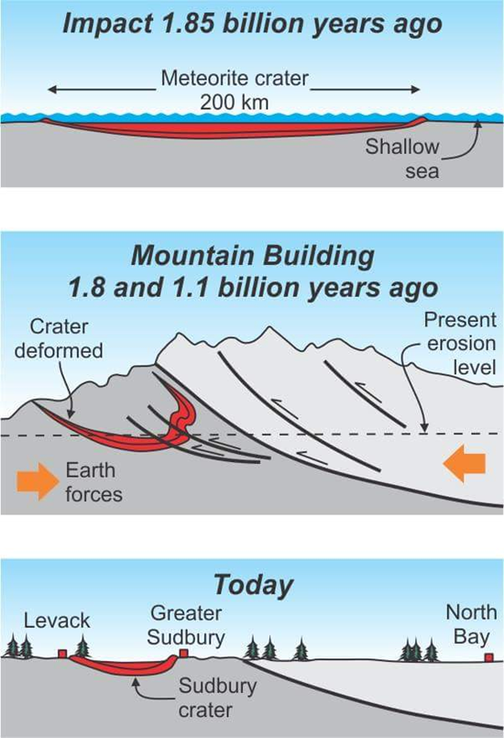
SUDBURY
Geology – Impact Structure
Source: https://craterexplorer.ca/sudbury-impact-structure-geomorphology/
36

Slide 37
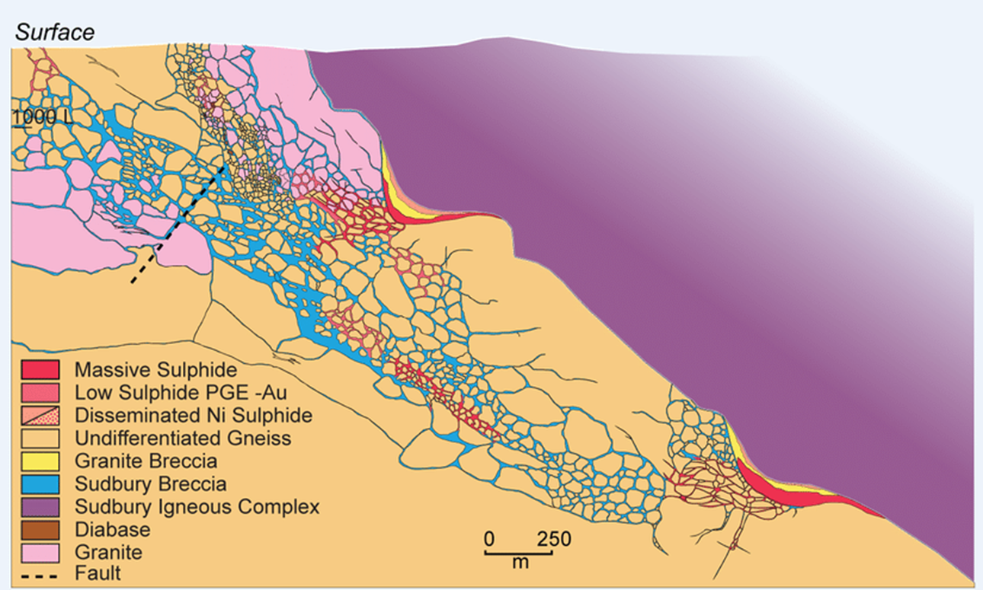
SUDBURY
Geology – Composite Cross Section
SUDBURY BRECCIA
Contact-type
NICKEL-COPPER
deposit
Footwall-type
COPPER-PRECIOUS METALS
deposit
Sudbury Igneous Complex (SIC)
37
Source: https://www.researchgate.net/figure/Composite-cross-section-showing-the-geological-settings-for-North-and-East-Range-type_fig1_259005801

Slide 38
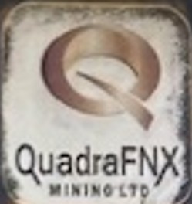
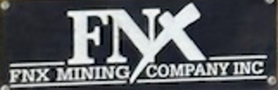
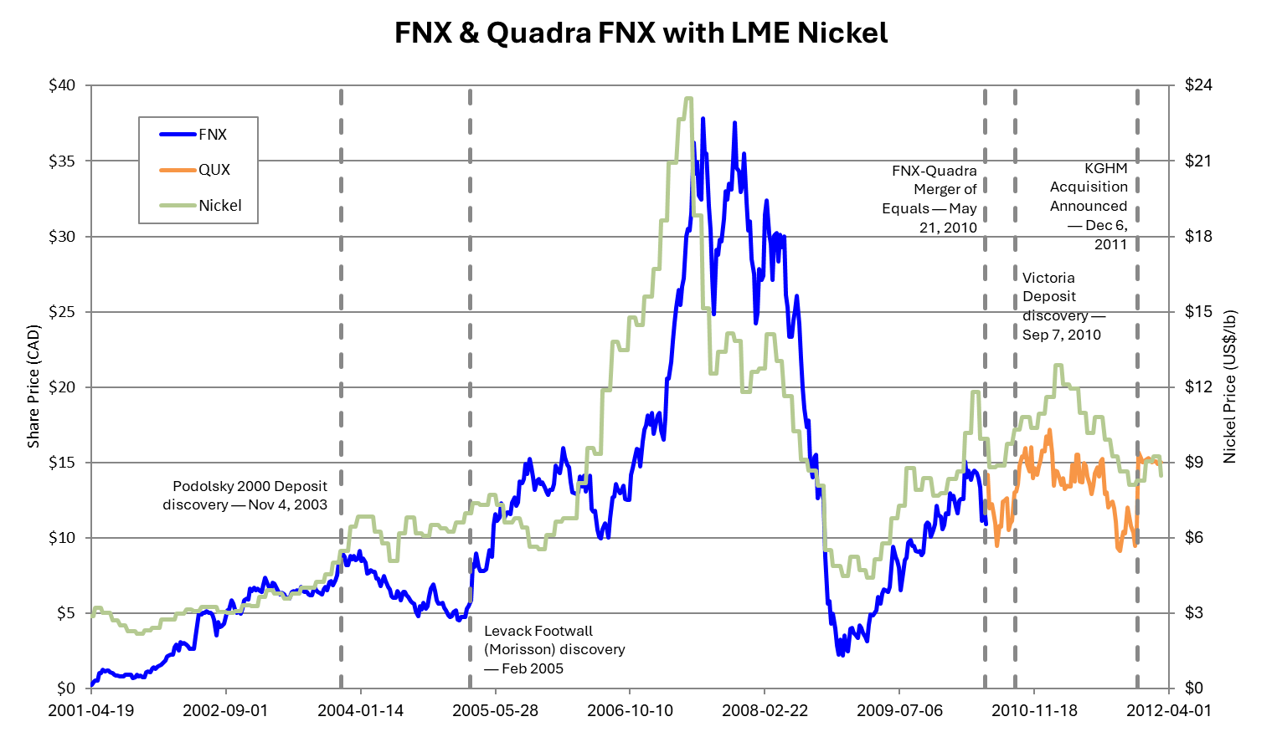

SUDBURY
FNX Historical Share Price Performance
Source: Bloomberg & Company Filings
38

Slide 39
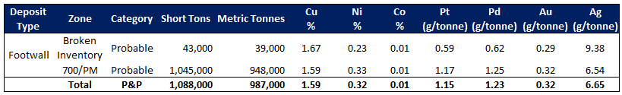
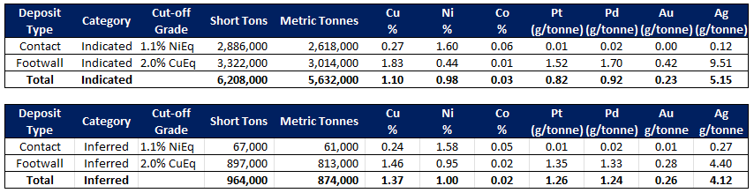
McCreedy West
Reserve and Resource Estimates¹
¹ See Footnotes to the McCreedy West Mineral Reserve & Mineral Resource Estimate.
39

Slide 40
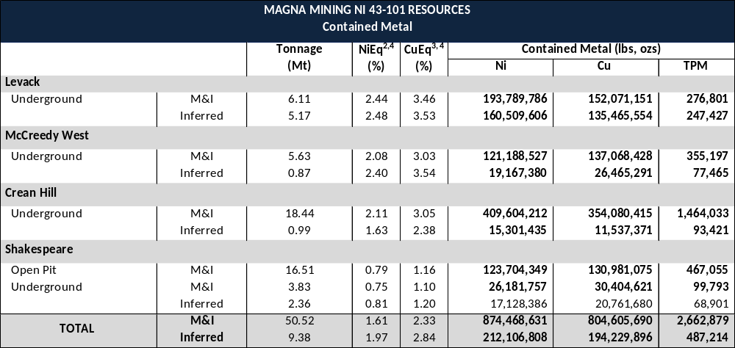
MAGNA MINING
Mineral Resource Estimates
Total Contained Metal in NI 43-101 Compliant Resources (Measured & Indicated)
Additional Contained Metal in Historic Resources¹
  805 million lbs of copper
  875 million lbs of nickel
  2.7 million ounces of precious metals (Pt + Pd + Au)
  2.6 billion lbs of copper equivalent (CuEq)
¹Historical Resources: a qualified person has not done sufficient work to classify the historical resource estimate as a current mineral resource and Magna is not treating the historical resource estimate as a current mineral resource.
²NiEq % = ( (Ni% x 2204 x Ni Price $/lb) + (Cu% x Cu Recovery % x 2204 x Cu Price $/lb) + (Co% x Co Recovery % x 2204 x Co Price $/lb) + (Pt gpt x Pt Recovery % / 31.1035 x Pt $/oz) +(dt gpt x Pd Recovery % / 31.1035 x Pd $/oz) + (Au gpt x Au Recovery % / 31.1035 x Au $/oz)) / 2204 x Ni $/lb. For NiEq, all metals have a recovery applied except Ni, and for CuEq all metals have a recovery applied except Cu.
³CuEq % = ( (Ni% x Ni Recovery % x 2204 x Ni Price $/lb) + (Cu% x Recovery % x 2204 x Cu Price $/lb) + (Co% x Co Recovery % x 2204 x Co Price $/lb) + (Pt gpt x Pt Recovery % / 31.1035 x Pt $/oz) +(dt gpt x Pd Recovery % / 31.1035 x Pd $/oz) + (Au gpt x Au Recovery % / 31.1035 x Au $/oz)) / 2204 x Ni $/lb.
⁴Prices used in Ni Eq and Cu Eq calculations (US): $7.72/lb Ni, $4.88/lb Cu, $18.12/lb Co, $1,410/oz Pt, $1,156/oz Pd, $3,815/oz Au.

Slide 41
MAGNA MINING
Historical Resources
Historical Resources¹
Property | Deposit Type | Tonnes | Ni (%) | Cu (%) | Co (%) | Pt (g/t) | Pd (g/t) | Au (g/t) | Ag (g/t)
Measured & Indicated
Podolsky | Contact | 6,058,000 | 0.75 | 0.21
Podolsky | Footwall | 1,099,900 | 0.27 | 2.35 | - | 1.01 | 1.01 | 0.42 | 13.56
Kirkwood | Contact | 565,000 | 1.17 | 0.49
Total |  | 7,722,900 | 0.71 | 0.54 | - | 0.14 | 0.14 | 0.06 | 1.93
Inferred
Podolsky | Footwall | 526,000 | 0.23 | 1.98 | - | 0.65 | 0.76 | 0.34 | 8.91
Kirkwood | Contact | 1,589,000 | 1.27 | 0.97
Total |  | 2,115,000 | 1.01 | 1.22 | - | 0.16 | 0.19 | 0.08 | 2.22
¹See endnotes for Historical Resource Estimate.
41

Slide 42
Notes on McCreedy West Reserve & Resource Estimates and Historical Resources
¹Notes on Mineral Reserves
The effective date of the McCreedy West Mineral Reserve Estimate is December 31, 2025.
Mineral Reserves are in addition to Mineral Resources.
The Mineral Reserve estimate was prepared under the supervision of Mr. William van Breugel, P.Eng., B.A.Sc. Geological Engineering, Associate Engineer of SGS Geological Services and Mr. Henri Gouin, P.Eng., of SGS Geological Services, both are considered a “Qualified Person” as defined by NI 43-101.
Mineral Reserves are based on metal prices of $7.72/lb Ni, $4.88/lb Cu, $18.12/lb Co, $1,410/oz Pt, $1,156/oz Pd, $3,815/oz Au, and $50/oz Ag. Metal recoveries considered are 85% for Ni, 91% for Cu, 68% for Co, 64% for Pt, 69.5% for Pd, 70.5% for Au, and 70% for Ag and a Cdn/Fx of $1.37.
A cut-off grade was applied to each stope based on NSR exceeding sustaining development, equipment and fixed plant capital costs and operating costs of $180.00 per ton.
Stope tons and grades include 3 feet of mining dilution for stopes and 85% stope recoveries.
Figures may not sum exactly due to rounding.
²Notes on Mineral Resources
The effective date of the McCreedy West Mineral Resource Estimate (“MRE”) is December 31, 2025. The MRE is based on drillhole assay data received up to September 10, 2025, which represents the cut-off date for assay data used in the estimate. The estimate has been depleted to account for all production through December 31, 2025.
The Contact Zone Mineral Resource was previously disclosed in 2024 and was estimated by Allan Armitage, Ph.D., P. Geo. of SGS Geological Services and is an independent Qualified Person as defined by NI 43-101. Dr. Armitage conducted two site visits to the McCreedy Property Mine, on August 22-23, 2023 (surface tour) and July 24, 2024. Mined material from 2024 was depleted from the previous MRE.
The Footwall Zone Mineral Resource was estimated by Jonathan Cirelli, P.Geo. of Orix Geoscience Inc. and is an independent Qualified Person as defined by NI 43-101. Mr. Cirelli was previously employed at McCreedy West Mine during 2010-2011. A site visit was last conducted on November 20, 2025. The Footwall Zone Mineral Resource has been reviewed by Mr. Armitage.
The Contact Zone Mineral Resource was previously disclosed in 2024 and was estimated by Allan Armitage, Ph.D., P. Geo. of SGS Geological Services and is an independent Qualified Person as defined by NI 43-101. Dr. Armitage conducted two site visits to the McCreedy Property Mine, on August 22-23, 2023 (surface tour) and July 24, 2024. Mined material from 2024 was depleted from the previous MRE.
The Mineral Resource is presented undiluted and in situ, constrained by diamond drillhole information and underground geological mapping, and is considered to have reasonable prospects for eventual economic extraction. Mineral Resources are exclusive of Mineral Reserves and mined-out material.
Mineral Resources are classified in accordance with the 2014 CIM Definition Standards for Mineral Resources and Mineral Reserves.
Mineral Resources, which are not Mineral Reserves have not demonstrated economic viability. An Inferred Mineral Resource has a lower level of confidence than that applied to an Indicated Mineral
Resource and must not be converted to a Mineral Reserve. There is no certainty that Inferred Mineral Resources will be converted to Indicated Mineral Resources through continued exploration.
All figures are rounded to reflect the relative accuracy of the estimate and numbers may not add due to rounding.
The Footwall Zone cut-off grade of 2.0% CuEq considers metal prices of $7.72/lb Ni, $4.88/lb Cu, $18.12/lb Co, $1,410/oz Pt, $1,156/oz Pd, $3,815/oz Au, and $50/oz Ag. Metal recoveries considered are 85% for Ni, 91% for Cu, 68% for Co, 64% for Pt, 69.5% for Pd, 70.5% for Au, and 70% for Ag.
The Contact Zone cut-off grade of 1.1% NiEq considers metal prices of $8.50/lb Ni, $3.75/lb Cu, $17.00/lb Co, $950/oz Pt, $1,100/oz Pd and $1,950/oz Au. Metal recoveries considered are 78% for Ni, 95.5% for Cu, 56% for Co, 69.2% for Pt, 68% for Pd and 67.7% for Au. Silver was not considered in the Contact Zone cut-off grade.
Footwall Zone grades for Ni, Cu, Co, Pt, Pd, Au, and Ag are estimated using ~5.0 ft (1.52 m) composites assigned to that domain. To generate grade within the blocks, the inverse distance squared (ID2) interpolation method was used. Samples were capped before compositing when required. A density regression was calculated and used to populate density values in the model.
Contact Zone grades for Ni, Cu, Co, Pt, Pd, Au, and Ag are estimated using ~5.0 ft (1.52 m) capped composites assigned to that domain. To generate grade within the blocks, the inverse distance squared (ID2) interpolation method was used for all domains. Average density values were assigned based on a database of 45,525 samples.
The estimate of Mineral Resources may be materially affected by environmental, permitting, legal, title, taxation, socio-political, marketing, or other relevant issues.
Historical Resource Estimate Notes:
An MRE for the Podolsky Mine and Kirkwood Mine has been completed internally by KGHM International and is summarized on the slide titled “Historical Resources”. The MRE for the Podolsky Mine and Kirkwood Mine is considered historical in nature. Although the resource estimate has been prepared and disclosed in compliance with all current disclosure requirements for mineral resources or reserves set out in the NI 43-101 Standards of Disclosure for Mineral Projects and the classification of the historical resource as a Measured, Indicated and Inferred resource is consistent with current 2014 CIM Definition Standards - For Mineral Resources and Mineral Reserves, a qualified person has not done sufficient work to classify the historical resource estimate as a current mineral resource and Magna is not treating the historical resource estimate as a current mineral resource.
42

Slide 43
Notes on Levack Resource Estimate
Levack Mineral Resource Estimate Notes:
The effective date of the Levack Mine Mineral Resource Estimate (MRE) is August 31, 2025. This is the close out date for the final mineral resource models and mine out models (as-builts).
The mineral resources are reported at a cut-off grade of 2.00% CuEq for Contact deposits and 2.50% CuEq for Footwall deposits. Values in this table reported above and below the cut-off grades should not be misconstrued with a Mineral Resource Statement. The values are only presented to show the sensitivity of the block model estimates to the selection of cut-off grade.
CuEq is calculated using metal prices of $4.50/lb Cu, $7.31/lb Ni, $15.00/lb Co, $1,291/oz Pt, $1,031/oz Pd ,$3,324/oz Au, and $37.40/oz Ag. Metal recoveries considered are 91% for Cu, 85% for Ni, 68% for Co, 64% for Pt, 69.5% for Pd, 70.5% for Au, and 70% for Ag.
The mineral resource was estimated by Jonathan Cirelli, P.Geo. of Orix Geoscience Inc. and is an independent Qualified Person as defined by NI 43-101. A site visit was conducted on July 9th, 2025.
The classification of the current Mineral Resource Estimate (MRE) into Indicated and Inferred mineral resources is consistent with current 2014 CIM Definition Standards - For Mineral Resources and Mineral Reserves.
All figures are rounded to reflect the relative accuracy of the estimate and numbers may not add due to rounding.
The mineral resources are presented undiluted and in situ, constrained by diamond drillhole information and previous underground geological mapping, and are considered to have reasonable prospects for eventual economic extraction. The mineral resource is exclusive of mined out material. The drillhole database includes data from 10,525 surface and underground diamond drill holes completed between 1911 and 2025. The drilling totals 4,382,756 ft (1,335,864 m) including 341,394 assay intervals representing 1,393,512 ft (424,742 m) of data.
Mineral resources which are not mineral reserves do not have demonstrated economic viability. An Inferred Mineral Resource has a lower level of confidence than that applying to an Indicated Mineral Resource and must not be converted to a Mineral Reserve. It is reasonably expected that most Inferred Mineral Resources could be upgraded to Indicated Mineral Resources with continued exploration.
Grades for Ni, Cu, Co, Pt, Pd, Au, and Ag are estimated for each mineralization domain using ~2.0 ft (0.61 m), 2.5 ft (0.76 m), or 5.0 ft (1.52 m) composites assigned to that domain, depending on the style of mineralization. To generate grade within the blocks, the inverse distance squared (ID2) interpolation method was used for all domains. Samples were capped before compositing when required.
Reliable density measurements were available for 21% of the samples in the drillhole database (71,712 measured samples) allowing for zone-specific Ni and Cu-based regression formulas to be created and applied to estimate missing densities.
43

